Slide 1
IV Drip Dubai
Do you need a solution to treat flu symptoms, fatigue, and jet lag? Or are you looking for way to look fresher, cleanse your body of toxins, and increase your energy levels. It may sound like you need more than one treatment, but the IV Drip Dubai can prove this otherwise.

Slide 2
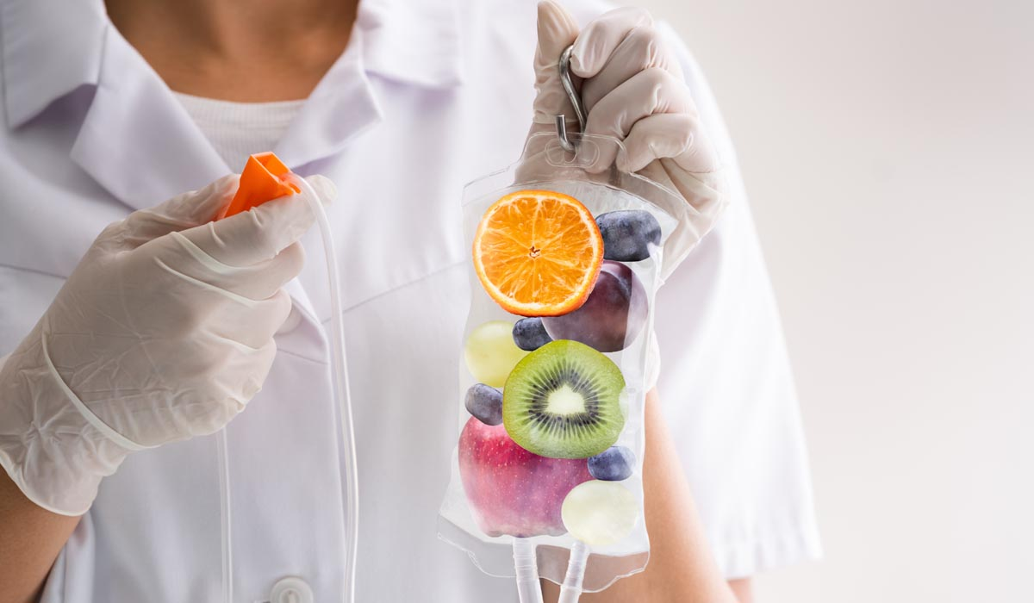
IV Drip Dubai

Slide 3
IV Drip Dubai
Vitamin Drip Therapy is a trendy wellness treatment that has gained popularity in Dubai. This therapy is a quick and efficient way to boost your vitamin levels and increase your energy levels. However, many people are curious about whether this treatment is genuinely beneficial or just another wellness fad. In this article, we will explore Vitamin Drip Therapy in Dubai and answer some of the most common questions surrounding this therapy.
What is Vitamin Drip Therapy?
  Vitamin Drip Therapy is a type of intravenous therapy that delivers a combination of vitamins and minerals directly into your bloodstream. This treatment involves the use of an IV drip bag that is infused with a combination of vitamins, including Vitamin C, B-complex, and other minerals. The IV drip bag is attached to a catheter, which is inserted into your arm, allowing the solution to be slowly delivered into your bloodstream.
  The Benefits of Vitamin Drip Therapy
  Vitamin Drip Therapy is becoming increasingly popular in Dubai, and for good reason. Some of the benefits of this therapy include:

Slide 4
IV Drip Dubai
Increased Energy Levels
One of the most significant benefits of Vitamin Drip Therapy is increased energy levels. The combination of vitamins and minerals delivered in the IV drip can help boost your energy levels, making you feel more awake and alert.
Improved Immune System
The vitamins and minerals delivered in the IV drip can help strengthen your immune system, making you less susceptible to illnesses and infections.
Faster Recovery Time
Vitamin Drip Therapy can help reduce the time it takes for your body to recover from illness or injury. The vitamins and minerals delivered in the IV drip can help speed up the healing process and reduce inflammation.
Improved Skin Health
The vitamins and minerals delivered in the IV drip can help improve the health of your skin, reducing the appearance of wrinkles and fine lines.
Increased Hydration
Vitamin Drip Therapy can help improve your hydration levels, making you feel more refreshed and energized.

Slide 5
Contact Us
Address: Villa 1091, Al Wasl Road, Al Manara Area (On the junction of AlThanya & Al Wasl Road) Dubai
Mobile: 971 561772998
Website: www.dynamiclinic.com

