Slide 1
Metabolic Surgeon in Dubai
Metabolic Surgeons in Dubai at Dynamic clinic Dubai are qualified. They can help you recover from different health issues.

Slide 2
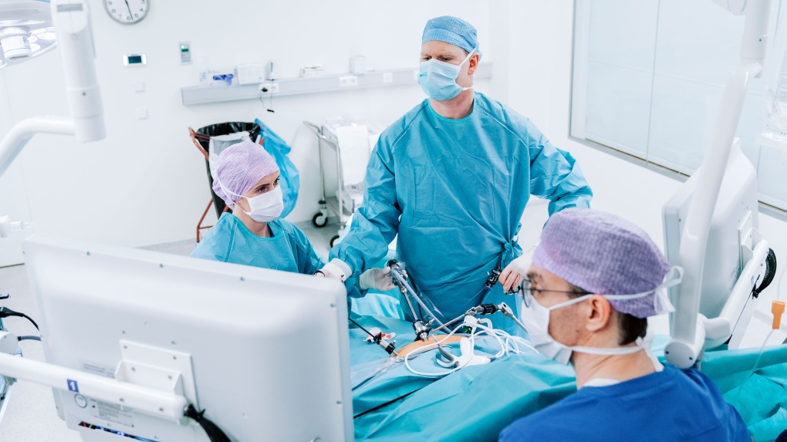
Metabolic Surgeon in Dubai

Slide 3
Metabolic Surgeon in Dubai
Are you looking for a way to improve your metabolism and achieve a healthier lifestyle? If you are based in Dubai, you may have heard about metabolic surgery, a new and promising option for those struggling with obesity and related health conditions. In this article, we will provide an overview of metabolic surgery and its benefits, discuss the qualifications and experience you should look for in a Metabolic Surgeon in Dubai, and answer some frequently asked questions about this procedure.
Overview of Metabolic Surgery
Metabolic surgery, also known as metabolic and bariatric surgery, is a type of surgery that aims to improve the metabolism of a patient. The surgery is typically recommended for people with a body mass index (BMI) of 40 or higher, or for those with a BMI of 35 or higher who have other health conditions such as type 2 diabetes or sleep apnea.
The most common types of metabolic surgery include gastric bypass, sleeve gastrectomy, and gastric banding. These procedures work by reducing the size of the stomach, limiting the amount of food that can be consumed and leading to weight loss. Additionally, metabolic surgery can help regulate blood sugar levels, improve cardiovascular health, and reduce the risk of certain types of cancer.

Slide 4
Metabolic Surgeon in Dubai
Qualifications and Experience of a Metabolic Surgeon in Dubai
If you are considering metabolic surgery, it is essential to find a qualified and experienced surgeon who can perform the procedure safely and effectively. Here are some qualifications and experience you should look for in a metabolic surgeon in Dubai:
Board Certification
Make sure the surgeon you choose is certified by a recognized board such as the American Board of Surgery or the European Union of Medical Specialists. Certification ensures that the surgeon has completed rigorous training and has passed an exam in the field of metabolic surgery.
Experience
Look for a surgeon who has performed a large number of metabolic surgeries and has experience in treating patients with conditions similar to yours. Ask for their success rates and complication rates to get an idea of their level of expertise.
Technology and Facilities
Choose a surgeon who uses the latest technology and has access to state-of-the-art facilities. The surgeon should be able to provide you with a comprehensive pre- and post-operative plan, including dietary and lifestyle changes, to ensure the best possible outcome.

Slide 5
Contact Us
Address: Villa 1091, Al Wasl Road, Al Manara Area (On the junction of AlThanya & Al Wasl Road) Dubai
Mobile: 971 561772998
Website: www.dynamiclinic.com

