Slide 1
Gastric Balloon in Dubai
It is a minimally invasive procedure that helps individuals lose weightin Dubai. In this procedure, the surgeon places a silicone balloon in the stomach. He then inflates the Gastric Balloon in Dubai with the saline solution. This Inflation occupies the space in the stomach and decreases the appetite of the person. It also makes the person fuller sooner. However, the doctors ask the patient to continue the diet and exercise with this procedure. The balloon lasts for six months or more in the stomach.

Slide 2
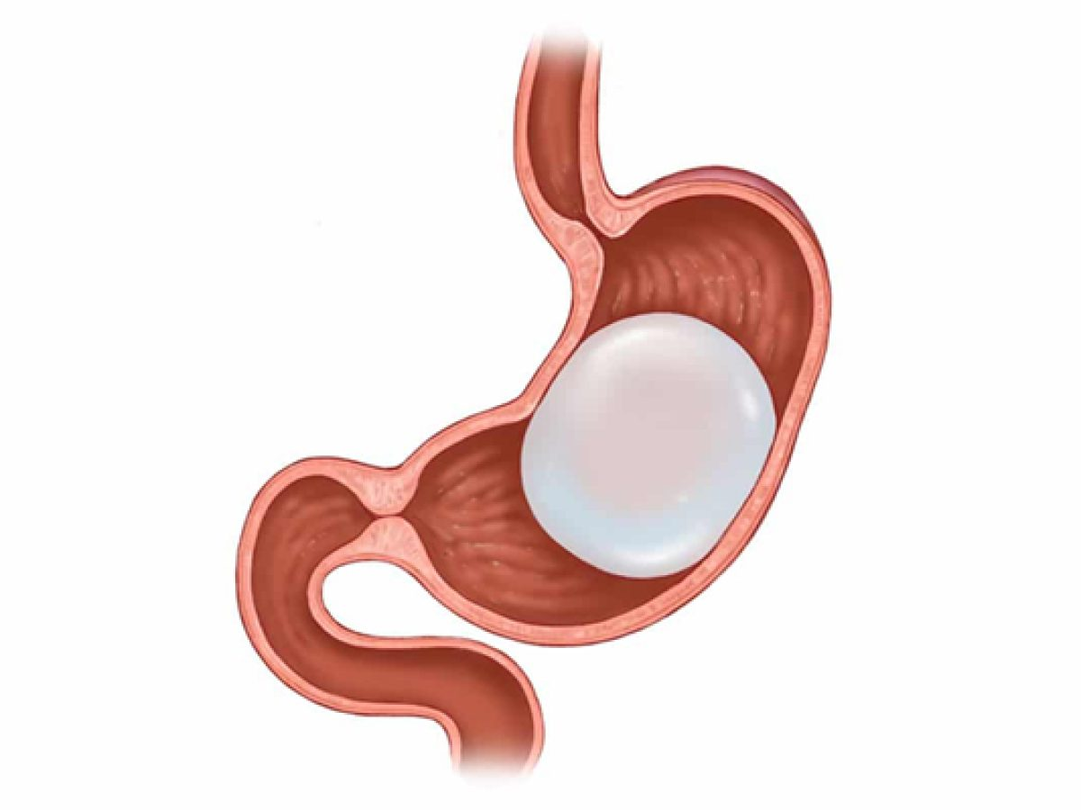
Gastric Balloon in Dubai

Slide 3
Gastric Balloon in Dubai
Obesity is a growing problem worldwide, and many people struggle to lose weight through traditional diet and exercise methods. In recent years, a number of weight loss procedures have been developed to help people achieve their desired weight, including the Gastric Balloon procedure in Dubai.
If you're considering this procedure, you may be wondering how much weight you can expect to lose. In this article, we'll take a closer look at the gastric balloon procedure, its benefits and risks, and what kind of weight loss results you can expect.
What is a Gastric Balloon?
A Gastric Balloon in Dubai is a non-surgical weight loss procedure that involves placing a soft silicone balloon into the stomach to reduce the amount of food a person can eat.
The procedure is done under sedation, and the balloon is placed into the stomach through the mouth using an endoscope. Once inside the stomach, the balloon is filled with saline solution, which makes it expand and take up space in the stomach.

Slide 4
Gastric Balloon in Dubai
How Does a Gastric Balloon Work?
The Gastric Balloon Dubai works by reducing the amount of food a person can eat by taking up space in the stomach. When the stomach is full, it sends a signal to the brain to stop eating, so by filling up space in the stomach, the balloon helps to reduce hunger and limit the amount of food a person can eat. The procedure also helps to slow down the digestion process, which means that a person feels fuller for longer after eating.
What Are the Benefits of a Gastric Balloon?
One of the main benefits of a Gastric Balloon in Duabi is that it's a non-surgical weight loss procedure, which means that it's less invasive than other weight loss surgeries like gastric bypass or sleeve gastrectomy. It's also a reversible procedure, which means that the balloon can be removed if necessary. Other benefits of the gastric balloon procedure include:
Rapid weight loss
Improved health and quality of life
Reduced risk of obesity-related health problems
Improved mobility and energy levels

Slide 5
Contact Us
Address: Villa 1091, Al Wasl Road, Al Manara Area (On the junction of AlThanya & Al Wasl Road) Dubai
Mobile: 971 561772998
Website: www.dynamiclinic.com

