Slide 1
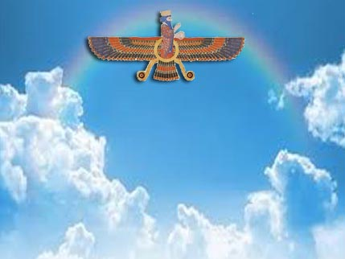
ZARATHUSHTRA’S GATHAS
A Presentation
Compiled by Kersee Kabraji
based on
Hymns of Zarathushtra - Dinshaw Irani
Gatha’s of Zarathushtra by Pilloo Nanavutty
Mr. Keki Bhote’s Lecture WZC 1996
Zoroastrian Theology by Dr. M.N. Dhalla
And other sources

Slide 2
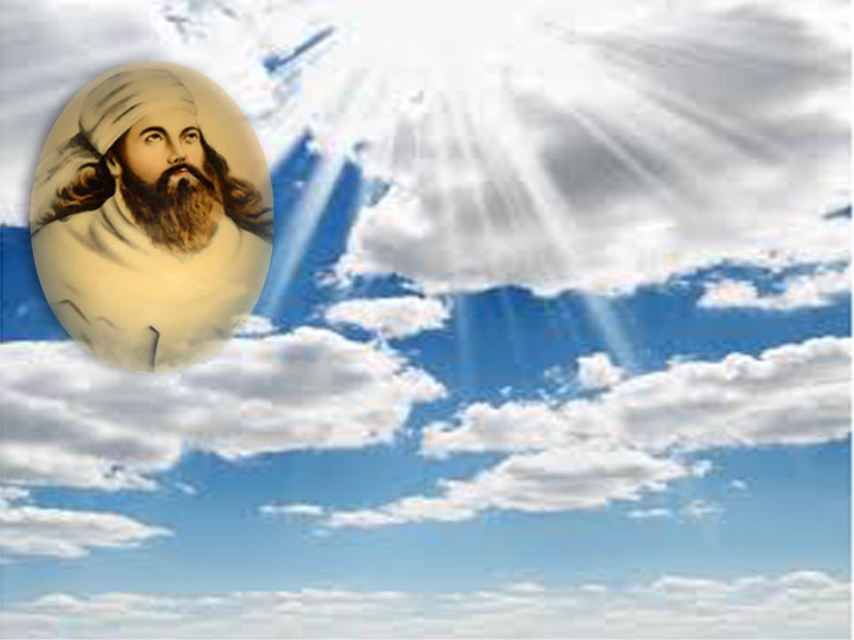
TO DISCUSS
Thanks
Self introduction
Feed-back most welcome
Mind Set

Slide 3

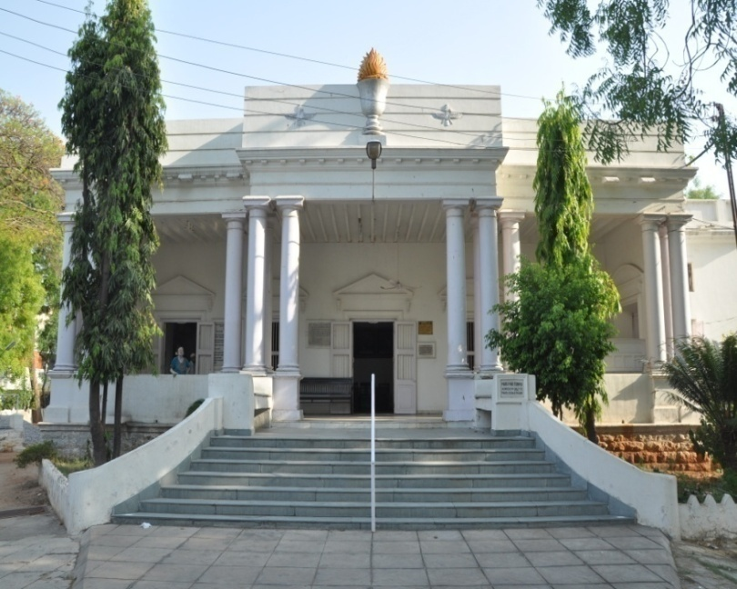
RELIGIOUS PRACTICES OBSERVED (we are all different human beings)
Visiting places of worship
Following rituals and ceremonies
Bartering with God
Community
Hold power over the masses
Mysticism
Orthodoxy
Acts of service to humanity
Following strong ethics and principles

Slide 4

WHAT IS ZOROASTRIANISM ?
Zoroastrianism, as Prophet Zarathushtra proclaimed, is about 3000 years old
In its present form, its religious thoughts and practices have been influenced by different doctrines over this vast period of time
Not everything that is covered under its name today has come from Asho Zarathushtra, its proclaimer

Slide 5

THREE COMMANDMENTS
In a capsulated form it’s philosophy is put
in three simple words:
GOOD THOUGHTS (HUKHTA, MANASHNI)
GOOD WORDS (HUMATA, GAVASHNI)
GOOD DEEDS (HUVARESHTA, KUNASHNI)
SOME ALSO CALL IT
‘RELIGION OF GOOD CONSCIENCE’
‘REFLECTIVE RELIGION’

Slide 6

THREE PRAYERS
Ashem Vohu
Ahnuvar
Yenghe Hatam

Slide 7

ASHEM VOHU
ASHEM VOHU VAHISHTAM ASTI
USHTA* ASTI USHTA AHMAI
HYAT ASHAI VAHISHTEM ASHEM
“RIGHTEOUSNESS IS THE BEST GOOD,
IT IS ENLIGHTENMENT
* ENLIGHTENMENT IS TO ONE WHO IS
RIGHTEOUS FOR THE SAKE OF BEST RIGHTEOUSNESS.”
Kanga
*ALSO TRANSLATED AS ‘HAPPINESS’, ‘BLISS’

Slide 8

AHNUVAR
YATHA AHU VAIRYO, AHTHA RATUS ASHACHIT HACHA, VANGHEUSH DAZDA MANANGHAO
SHYOTHANANAM ANGHEUSH MAZDAI XSHANOTHREMCHA AHURAI A YIM DRIGUYABIO
DADAT VASTARAM
“JUST AS THE RULER IS SUPREME, SO IS THE RELIGIOUS TEACHER THROUGH HIS RIGHTEOUSNESS,
BY THE DEEDS OF GOOD THOUGHT DONE BY A PERSON IN HELPING THE POOR MAKES FOR THE KINGDOM OF AHURA MAZDA.”
–Kanga

Slide 9

YENGHE HATAM
YENGHE HATAM AAT YESNE PAITI VANGHO
MAZDAO AHURO VAETHA ASHAT HACHA YAONGHAMCHA
TASCHA TAOSCHA YAZAMAIDE
“ALL HUMAN BEINGS WHOM MAZDA AHURA RECOGNISES AS PURER, IN EVERY ACT OF DEVOTION, EVER ASSOCIATED WITH RIGHTEOUSNESS, ALL SUCH WOMEN AND MEN WE ADORE AND HONOUR.”
– Khabardar

Slide 10

A BIRDS EYE VIEW OF THE HISTORY
The Pre-Gathic Period--from the earliest times to about 1200BC
The Gathic Period : about 1200BC to 800BC
The Avestan Period: about 800BC to 200AD at the latest
The Pahlavi Period : from 3rd to 9th century
A Period of Decadence : from 7th to 18th century
A Period of Revival : from 18th century and after

Slide 11
HISTORY OF ZOROASTRIANISM
PRE-GATHIC PERIOD | GATHIC PERIOD | AVESTAN PERIOD | PAHALAVI PERIOD | PERIOD OF DECADENCE | PERIOD OF REVIVAL
Earliest times – Abt.1200 BC | 1200 BC to Abt. 800 BC | Abt. 800 BC to Abt. 200 AD | 200 AD to Abt. 900 AD | 900 AD till 18th Century | 18th Century Onwards
Worship of Vayu, Usha, Baga, Homa, Perendi, Yazata, Airyaman, Mithra, etc. | Monotheism -- Amesa Spenta Vahu Manah, Asha, Armaity, Vahu Kshatra, Huvertat, Amertat, Atar. | Mixed scriptures of pre-gathic and Gathic thoughts. Ava, Mah, Tir, Ram, Zamin, Gosh and other Yashts. Magi’s, Vendidad, Amesa Spenta become Arch-Angels of Physical Objects. | 500 yrs of foreign rule-Shapoor II –translate all Avesta works to Pahlavi. Priests on cabinet | No religious scholarships. - Jamaspi Sad-dar Rivayets 3 questions | Anquetil du Burnoff, Spiegel Westergaad Dermesteter, Hombach. Insler, K.R. Cama, Sanjana, Modi, Bode, Chatterji, Dr.M.N.Dhalla, Nanavutty, Kanga, Dadachanji, Wadia A, Bharucha, Anklesaria, Taraporewalla.
Animals sacrificed | Twin mentality Shroasa Hamkar |  |  | Padania’s dokhma
Karpans, Kavis, Sorcerers. | Morality as basis of religion. | -invasion by Alexander. | Patet pashemani, start of dogmatism, Dinkard, bundehisn Arda Viraf Name.
Some names of Western as well as Zoroastrian Scholars have been inadvertently left out for want of space to accommodate all.
Kindly excuse the glaring omissions, if any.
This Chart is prepared from ‘THE HISTORY OF ZOROASTRIANISM’ by Dr. Maneckji N. Dhalla, Ph.D., Litt.D.
The High Priest of Parsis, Karachi. For any further clarification, kindly refer to this book.
Dr. Dhalla has Authored ‘Zoroastrian Theology’,’Zoroastrian Civilization’,Our Perfecting World-Zarathushtra’s way of Life’, etc.

Slide 12
ZARATHUSHTRA’S GATHAS
The Gathas or the Zoroastrian psalms—the ethics of Gathas --reveal his religion.
Zarathushtra speaks of his faith in terms of a universal religion.
The only holy scripture, which has come straight and direct from Zarathushtra’s mouth is Gathas.
Everything else has been written by his followers, as per their understanding (and / or mis-understanding ) of the religion through the ages.

Slide 13

ZARATHUSHTRA’S GATHAS
‘After the Prophets depart, their disciples turn everyone into the blind followers of the faith. Religiosity replaces religion …… socio-religious customs take the place of pure ethical and devotional faith and turn it into tradition-ridden religion.’
(AB-pg viii)

Slide 14
CONCEPT OF ONE GOD – AHURA MAZDA
Gathas speak of only one God
– God of Good Life and wisdom
AHURA MAZDA
Ahura Mazda is supported by his six ministering angels called Amesha Spentas (in a personified way)—actually these are attributes of Ahura Mazda–these are abstract concepts.

Slide 15
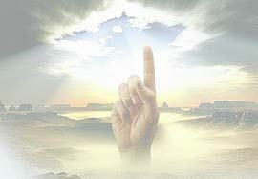
AHURA MAZDA
The Concept of One High God
“Zarathushtra uplifted the concept of God from the animism, paganism, and polytheism of the ancient world into a resplendent monotheism -one supreme Almighty, Ahura Mazda.”

Slide 16

AHURA MAZDA
Described in Gathas as:
The First one (Ys.31.7)
Virtuous
Friend –He does not punish
Law giver and Judge (Ys 31.8)
Eternal
Omniscient
Constructive and beneficent (ys51.6, 47.3)

Slide 17
AMESH SPENTA
Vohu Mana Good Mind
Asha Righteousness
Vohu Khshathra Power
Armaiti Devotion Piety
Haurvatat Perfection
Ameretat Eternity

Slide 18
ZARATHUSHTRA’S GATHAS
Also mentioned in Gathas are :
Sroasha
Athar (Fire)
Twin Mentalities
Concept of Hamkar

Slide 19

VAHU MANAH
THE GOOD MIND
THE POWER TO THINK—TO START THE PROCESS OF ‘GOOD THOUGHTS’
THERE IS NO EQUIVALENT IN ANY OF THE VEDAS OR REVEALED RELIGIONS ---Pilloo Nanavutty
‘DIVINE INTELLENCE GIVEN TO HUMAN BEINGS’,--
(‘BUDHDHI’, ‘AKKAL’ --KK)
In Later Avesta , Vohu Manah becomes ‘Behman’
and Arch-Angel of Animals.

Slide 20
ASHA
Asha is usually translated as Truth. Truth in this context means the Ultimate Truth, that is the ideal form of Existence of the world as envisaged by Ahura Mazda.
Acting in accordance with the Truth is the right thing to do, hence Asha is also translated as Righteousness.

Slide 21

ASHA
TRUTH,
RIGHTEOUSNESS,
JUSTICE, SENSE OF FAIR PLAY,
COSMIC ORDER (Purity, Sacredness,…)
‘RTA’ IN VEDAS
In Later Avesta, Asha becomes Asha Vahista, Arta-Vahista, Ardibehest, Arch-Angel of Humanity

Slide 22
VOHU KHSHATHRA
POWER
SOVEREIGNITY
‘WISHED FOR KINGDOM’
VEDIC ‘KSHTRA’
In Later Avesta Vahu Khshathra becomes Khshtra variya, Sheherevar-Arch Angel of Metals, Minerals.

Slide 23

ARMAITY
DEVOTION , COMMITTMENT
PIETY, ZEAL
LOVE, SERENITY
RIGHT-MINDEDNESS
VEDIC ‘ARAMATI ’
In Later Avesta it becomes Spenta Armaity—Spentamard—Aspendiard--arch angel of Earth
(COMMITMENT--?—KK)

Slide 24
HAURVATAT
PERFECTION, WELL-BEING, HEALTH
“The State of complete Well-being, physical and spiritual integrity. In its full form it is state of perfection on earth”.
VEDIC ‘SARVATAT’
In Later Avesta it becomes Khordad--arch angel of water

Slide 25
AMERETAT
IMMORTALITY
VEDIC ‘AMRUTATAT’
In Later Avesta it becomes Amerdad—arch Angel of vegetable Kingdom

Slide 26

TAKE UP GROUP EXERCISE
BEFORE GOING FURTHER

Slide 27

POSITIVE NEGATIVE
LOVE
AFFECTION
FRIENDLINESS
TRUST-CONFIDENCE
FAITH – BELIEF
HOPE
HATE
ANGER
HOSTILITY
DISTRUST-DIFFIDENCE
DOUBT- SUSPICION

Slide 28
POSITIVE NEGATIVE
ENTHUSIASM-ZEAL
OPTIMISM
GENEROSITY
FORGIVENESS
COURAGE- CHEER
MODESTY
FRUSTRATION, DEPRESSI0N
PESSIMISM
PETTY-MINDED-NESS
VENGEFUL
FEAR-ANXIETY, SORROW
HAUGHTINESS

Slide 29

ZARATHUSHTRA’S GATHAS
TWIN MENTALITIES
Spenta Mainyu : Positive or Progressive Mentality
Angra Mainyu : Negative or Regressive Mentality
Actually in Gathas ‘Angre Mainyu’ is not even mentioned. It is described as ‘that other Mentality’.

Slide 30
ZARATHUSHTRA’S GATHAS
TWIN MENTALITIES
“Now in the beginning these two mentalities, the twins, revealed themselves in vision as the better and the bad in thought, word and deed. The wise and the generous chose correctly between these two, but the unwise and the mean did not.”
(Ys. 30.3—Piloo Nanavutty)

Slide 31
ZARATHUSHTRA’S GATHAS
SROASHA
–the raiser of the inner Conscience through
Intelligent enquiry
“I will now invoke for You and for the Final Goal the most mighty Sraosha (willing obedience to Mazda)
Only then can I gain the long-lasting Sovereignty of the Good Mind along the straight path of Truth wherein You, O Ahura Mazda dwell.”
'introspector-inner policeman?-kk
(Ys. 33.5—Nanavutty)

Slide 32
HOW TO OVERCOME
NEGATIVE MENTALITY ?

Slide 33
ZARATHUSHTRA’S GATHAS
Concept of
HAMKAR
Sadhu Vaswani’s article

Slide 34
Acting as Hamkar for perfecting the world.
These things are clear to the wise man as also to him who acquires the full realization of the good mind.
Such person upholds Truth and Sovereignty through his words and deeds. He will be your most helpful friend and ally, O Ahura Mazda.
(Ys.31.22 –Nanavutty)

Slide 35
ZARATHUSHTRA’S GATHAS
“With hands outstretched in Reverence, O Mazda, I pray for the abiding support of your ever-expanding spirit of benediction.
All my actions I dedicate to Truth.
May the Wisdom of the Good Mind guide me, so that I may gladden the soul of the living world (Gaush Urva).”
(Ys. 28.1 --Nanavutty)

Slide 36
ZARATHUSHTRA’S GATHAS
“When I conceived of Thee, O Mazda, as the very First and the Last, as the most Adorable One, as the Father of Good Thought, as the Creator of Truth and Right, as the Lord Judge of our actions in life, then I made a place for Thee in my very eyes”
(Ys. 31.4—D.J. Irani)

Slide 37
ZARATHUSHTRA’S GATHAS
‘In Gathas Zarathushtra details several principles that has made Zoroastrianism the most rational religion in the world, and more important, one that is ideally suited to fit the yearnings of modern man.’
…Keki Bhote

Slide 38
MESSAGES OF GATHAS-1
FREEDOM OF CHOICE AND WILL
"Hear the best (truth) with your ears and decide by your pure mind. Let everyone judge for his own self and find out what he ought to do. Before the great trial let all wake up to this my counsel"
(Ys. 30.2--Sethna)
(Also: 31.2, 31.11, 34.9,10,12,13 45.2,9,11 etc)

Slide 39
MESSAGES OF GATHAS-2
FREEDOM OF CHOICE AND WILL
Since O Mazda from the beginning Thou didst fashion for us physical bodies, discerning souls and directive intelligences through Thy own mind; since thou didst infuse life-breath into mortal bones, since thou grant us capacities to act and true doctrines to guide so that one could choose beliefs at will.
(Ys. 31-11 Bode & Nanavutty)

Slide 40

MESSAGES OF GATHAS-3
RESPONSIBILITY FOR CONSEQUENCES
“I realized You, God Wise, to be progressive when I saw You at the birth of life, and found that You have ordained that actions and words should have consequences : bad for bad, and a good reward for good. It shall be so through Your excellence until the final turn of creation.”
(Ys.43.5--Jafarey also 53.6,8,9)

Slide 41
MESSAGES OF GATHAS-4
THE SPIRIT OF SERVICE (HAPPINESS UNTO OTHERS)
“Happiness be the lot of him who works for the happiness of others. May the Lord grant him health and endurance. For the efforts to uphold Truth, I beseech these very gifts from Thee! Mayest Thou, through Armaiti, the spirit of Right-mindedness, Bless me with the perfection of a life guided by the Good Mind !
(Ys.43.1—D.J.Irani --also 34.3,43.6,44.12/13;50.3)

Slide 42
MESSAGES OF GATHAS-4
THE SPIRIT OF INDEPENDENT INQUIRY
“Therefore grant me Truth whom I invoke.” Then Ahura Mazda replied:
“ I come to you with my daughter, Armaiti, (full of love and compassion), Place before us your searching questions for by that questioning you will gain the Sovereignty by which you will obtain understanding.”
(Ys.43.10- Piloo Nanavutty
--also 34.3,43.6,44.12/13;50.3)

Slide 43
MESSAGES OF GATHAS-5
ESHATOLOGY—HEAVEN AND HELL
“The follower of the righteous shall attain the Abode of Light ; But he who deceived the good and the righteous, for him shall the future be long life of misery and darkness , woe and despair,
O ye evil lives! Your own deeds will lead you to this dark existence.”
(Ys. 31.20—D.J.Irani)

Slide 44
MESSAGES OF GATHAS-6
Acceptance into Zoroastrianism
Come hither to me, in Thine own self, O Mazda! Come unmistakably, O Thou Best One, with The Spirit of Truth and The Good Mind!
Let my message be heard beyond the limits of the community of adherents.
Let the brilliant offerings of reverential prayers be manifest to all.
(Ys.33-7 –D.J.Irani–also in 47.6,44.7,10,48.12….)

Slide 45
MESSAGES OF GATHAS-7
EQUALITY OF SEXES
Who ever, man or woman, does what Thou,
O Mazda Ahura, knowest to be the best in Life,
Whoever does right for the sake of Right,
Whoever in authority, governs with the aid of Good Mind;
I shall bring all these to join in songs of thy praise,
Forth, shall I with them cross the Bridge of Judgment.
(Ys.46.10—D.Irani)

Slide 46
MESSAGES OF GATHAS-8
Acting as Hamkar for perfecting the world.
These things are clear to the man of wise understanding and to one who acquires the full realization of the good mind. Such person with moral courage glorifies righteousness with words and deeds.
Such person O Mazda Ahura, shall be the most efficient helper on your side.
(Ys.31.22 –Sethna)

Slide 47
MESSAGES OF GATHAS-9
PROTECTION
OF
ENVIRONMENT

Slide 48
WHAT GATHAS DO NOT MENTION
BHAGYA-DESTINY
SIN -ATONEMENT

Slide 49
MESSAGES IN GATHAS-SUMMARY
Freedom of Choice and will
Taking responsibility for consequences
The spirit of service-Happiness unto others
The spirit of independent enquiry
Twin Mentalities—To choose the Positive
Protection of environment
Righteousness is the highest enlightenment
Helping the poor and needy is Godly act
Acceptance into Zoroastrian Faith
Acting as Hamkar for perfecting the world
Equality of sexes

Slide 50
CENTRAL MESSAGE OF GATHAS
Life is a Blessing--Live it fully with divine intelligence of VOHU MANAH, with +ve mentality of Spentamainyus coupled with Truth, Righteousness and sense of fair play of ASHA with Power of VOHU KHSHATHTRA and Dedication, Piety & Commitment of ARMAITI to make this world a perfect place-HAURVATAT- (as AHURA MAZDA desires it to be with the Co-operation of Mankind), so that our soul merges into Eternity of AMERETAT

Slide 51

QUOTE-1
This balanced practical knowledge, as Mathew Arnold terms it, ‘The quality of scientific intelligence’, is the hallmark of the Zoroastrian religion.
For in the final analyses, the practical side of a religion is more important than philosophical ideologies. Examining it from that standpoint, the Zoroastrian religion qualifies as being the finest of all religions.”
--Samuel Liang in ‘A Modern Zoroastrian’
pp 207,213,214.

Slide 52
QUOTE-2
“Though surrounded by the believers in magical rites, he proclaimed in those dark days of unreason that :
Religion has its truth in its moral significance, not in external practices of imaginary value;
that it is to uphold man in his life of good thoughts, good words and good deeds”
--Tagore in The Religion of Man

Slide 53
QUOTES-3
“Zarathushtra was the first man we know who gave a definitely moral character and direction to religion, and at the same time preached the doctrine of monotheism, which offered an eternal foundation of reality to goodness as an ideal of perfection.”
--Tagore

Slide 54
QUOTE-4
We might hardly conceive
what the human belief would be now,
had Zoroaster never existed.
---Francis Power Cobbe

Slide 55
QUOTE-5
Zoroaster’s unique achievement is based on “the battle for the transcendence of the one God against the demons that do not exist”,
a battle of ethical rebellion against the great number of false deities. He focused his attention almost exclusively on man’s behavior and its moral drives largely disregarding the ritualism of the worship of God.
—(Eckehard Kulke)--Jaspers

Slide 56

QUOTE-6
“Zoroastrianism, in my view, is not a religion as
Abrahamic religions have defined religion to be.
It is a way of life not bound by any commandments or
prescriptions.
It is a teaching based on free choice, integrity,
contribution, and inclusivity and premise of it all is
grounded in one’s wisdom. It is an enlightened state of
being in its true form.”
---J. Zarathosti

Slide 57
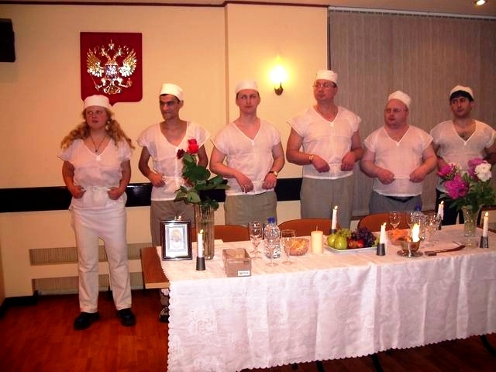

Slide 58
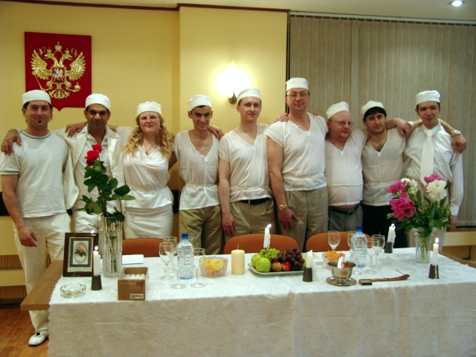

Slide 59
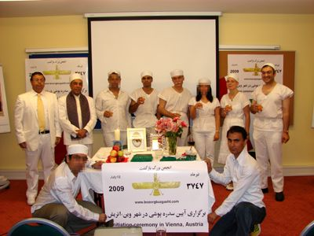

Slide 60
QUOTE-7
Gautama Buddha says - ‘Kalmo Satta’
- “Believe not what you hear;
- believe not legends;
- believe not gossip,
believe not what you are habituated to listening
to since childhood;
believe not because it comes from the lips of the
elders;
but apply it to your own study, examine it, ponder on it and believe only what your intelligence accepts.”

Slide 61
QUOTE-8
In Zoroastrianism man is the focal point upon whom the whole corpus of the good religion rests. He is seen to be the prime agent through whom the theory and practice of the religion are tested and put in to action for it is the task of man to bring about the final renovation and healing of the world.
Khojeste Mistree—in Zoroastrianism An Ethic Perspective

Slide 62
QUOTE-10
I only know that one such as Zarathushtra can
never die. The seasons may tire and the years
may grow old. But the life and teachings of this
prophet of Light that heals , will continue to
shed its radiance far and wide.
Contd-

Slide 63
QUOTE-10
Kingdoms may crumble and crowns may fall.
But the melody of the songs he sang will live
in many hearts.
It will hover from generation to generation and it will
spread from sphere to sphere, bringing blessings untold
to countless pilgrims to the city of light
--- J. P. Vaswani ..( ‘Mira’ East and West 1957)

Slide 64
QUOTE 11
Zoroaster, the first rationalist—
“Zoroaster was the first rationalist in the world. His doctrines stand the test of reason, scientific facts and human experience. Most of his verses begin with ‘Listen with your Best Mind’;
‘Pray for the Bounteous Words of Reason’;
‘Think over what I say giving supremacy to reason’; ‘Choose what ye will’; ‘The good chooseth the Right, wicked the Wrong’.
E. J. Divecha

Slide 65
Oxford Dictionary places Zarathushtra Number One (#1) in the chronology of philosophers.
Thus Zarathushtra is the first philosopher and the person who originated this field of study.
Zarathushtra is the founder and father of the
Rational System-philosophy (Mazda-Yasna).
This alone makes him father of humanity and
ethics, because before him there was only the belief systems. Zoroastrians worship wisdom and they educated the Greeks in this area.
--Sarosh As

Slide 66
CONCLUSION
Where do we go from here ?
Which religion
do we preserve or spread ?

Slide 67
CONCLUSION
A Parsee has to believe that for the salvation of his soul he has to look to nobody else, but to himself.
Nobody -- no priest, or no prophet -- will intercede for him. For his salvation he has only to look to the purity of his own thoughts, words, and actions".
Sir Jivanji Modi ‘(Navjot Ceremony’ 1914)

Slide 68
CONCLUSION
‘With sublime confidence Zarathushtra foretold to the evil spirit that his religion will ever live and his followers will do battle with the forces of evil up to the end of the world.’
His noble faith has weathered the heaviest of storms and survived them; and the religion which stood these trials in the past will stand any trial in the future

Slide 69
Zoroastrianism will live by
Its eternal verities of the belief in the personality of Ormazd,
An abiding faith in the triad of good thoughts good words, and good deeds,
The exorable law of righteousness,
The progress of the world towards perfection,
And the ultimate triumph of good over evil through coming of the Kingdom of Ormazd with the co-operation of man.

Slide 70
These are the truest and the greatest realities in life.
They are valid for all times. They constitute the lasting element of Zoroastrianism.
In the midst of the accretions that have gathered around it during the long period of its life, these immortal truths have remained substantially unchanged, and by them Zoroastrianism will live for all time.

Slide 71
Dogmas and rituals are based upon the needs of the times, and as such they are subject to the natural laws of growth and decay.
They have their place in the spiritual development of man.
They are the accompaniments of the religion, but not religion itself.
Man may fall away from dogmas and from rituals, and yet may remain religious.

Slide 72
Righteousness rests on the individual’s piety and not on a scrupulous observance of the ceremonials or a practice of elaborate lustrations.
Let the Parsi individually, and his community collectively, abide steadfast in the path of righteousness, and they will be practicing true Zoroastrianism.”

Slide 73
CONCLUSION
Q’s & A’s
What to ask from Ahura Mazda ?
Concluding Prayer Song

Slide 74
Khudavind Khudavind O Parvardigar!
Namu tari dadgahe hu khaksar,
  Dear God, I bow my head in reverence and service to you.
Thayo roj akher, sharu thai chhe raat,
Tane raji karvathi hu chhu pachhat
  The day is done and the night has just begun,
  And I am lagging behind in making you happy.

Slide 75
Dayalu Khudavind O jagna re baap
Manay maroo dahapan ne budhdhi tu aap
  O merciful God, the father of the world
  Give me wisdom and intelligence
Ke bhulo shdharu hamey roj ba roj,
Bhalai vadharun kari nitya khoj.
So that I may correct my mistakes day after day,
And increase the goodness by constant search.

Slide 76
Bhalun hakma mare te janoo nahi,
Bhalun je mane te tu jane sahi.
I am not aware what is good for me
but You know what is good for me.
Bahu aajijithi namine khuda,
Karun chhun dua aashisho de sada
With great obedience I entreat you O God,
To bestow your blessings on me for ever.

Slide 77
Ke tari madadthi hun rakhu vivek,
Manashni, gavashni, Kunashni nek.
  So that with your help I honor and respect
  Good thoughts, Good words and Good deeds.
Mane paashbanima tari suvad
Bhalan kamo karva savare uthad.
  Take me to sleep under your protection and
  Awaken me in the morning only to do good deeds.

Slide 78

THE END

Slide 79
DECLARATION
I,.........son/daughter of …………….hereby voluntarily and without seeking any economical, social or political gains, declare that:
I have understood Zarathushtra’s philosophy as proclaimed by him in his Gathas and would like to follow it in practice in my everyday life.
I shall follow the path of Truth, Righteousness, justice and a sense of fair play
I shall try and help needy human beings even by going out of my way
I shall try to be happy always and spread happiness to others

Slide 80
I shall operate through progressive and positive mentality of love friendliness trust……. And shun hatred, anger, violence
I shall practice Good Thoughts, Good Words, and Good Deeds every day, every hour, every minute and every moment of my life.
I commit myself to be a Hamkar of Ahura Mazda to bring peace, happiness and prosperity in this world.
Signed:……..……………Witness………
Signed by the Performing Priest ………..
Date: Place:

