Slide 1
Weight Loss Program Dubai
Dynamic Clinic is the best Weight Loss Program Dubai that provides non-surgical and surgical slimming treatments. We take pleasure in providing programs that are built in compliance with healthy weight-loss methods.

Slide 2
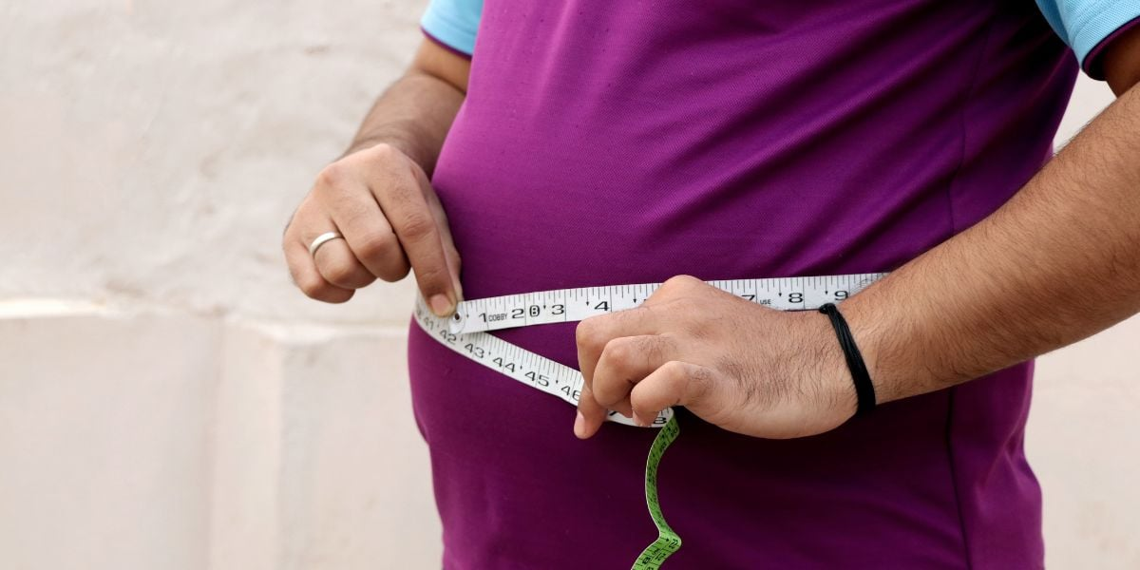
Weight Loss Program Dubai

Slide 3
Weight Loss Program Dubai
Are you looking to shed those extra pounds and achieve a healthier lifestyle? If you're in Dubai, you're in luck! Dubai offers a variety of weight loss programs tailored to meet your unique needs and goals.
In this article, we will explore the ins and outs of Weight Loss Programs in Dubai, helping you make an informed decision on the best program for you.
Introduction
Weight loss can be a challenging journey, and having the right program and support can make all the difference.
Dubai, known for its state-of-the-art facilities and wellness centers, provides a plethora of options when it comes to weight loss programs. Whether you're seeking a comprehensive program or a specialized approach, Dubai has it all.

Slide 4
Weight Loss Program Dubai
Understanding Weight Loss
Before delving into weight loss programs, it's essential to understand the concept of weight loss itself. Weight loss refers to the process of reducing body weight, typically by burning fat reserves and improving overall health. It involves a combination of dietary changes, physical activity, and behavioral adjustments.
The Importance of a Weight Loss Program
Embarking on a weight loss journey without a structured program can often lead to frustration and lack of results. A weight loss program provides you with a systematic approach, expert guidance, and a supportive environment to help you reach your goals effectively. It offers a roadmap to success and empowers you with the necessary tools for long-term weight management.

Slide 5
Contact Us
Address: Villa 1091, Al Wasl Road, Al Manara Area (On the junction of AlThanya & Al Wasl Road) Dubai
Mobile: 971 561772998
Website: www.dynamiclinic.com

