Slide 1

In vitro neurons learn and exhibit sentience when embodied in a simulated game-world
Brett J. Kagan, Andy C. Kitchen, Nhi T. Tran, Forough Habibollahi, Moein Khajehnejad, Bradyn J. Parker, Anjali Bhat, Ben Rollo, Adeel Razi, Karl J. Friston
Neuron
DOI: 10.1016/j.neuron.2022.09.001
Copyright © 2022 The Author(s) Terms and Conditions

Slide 2
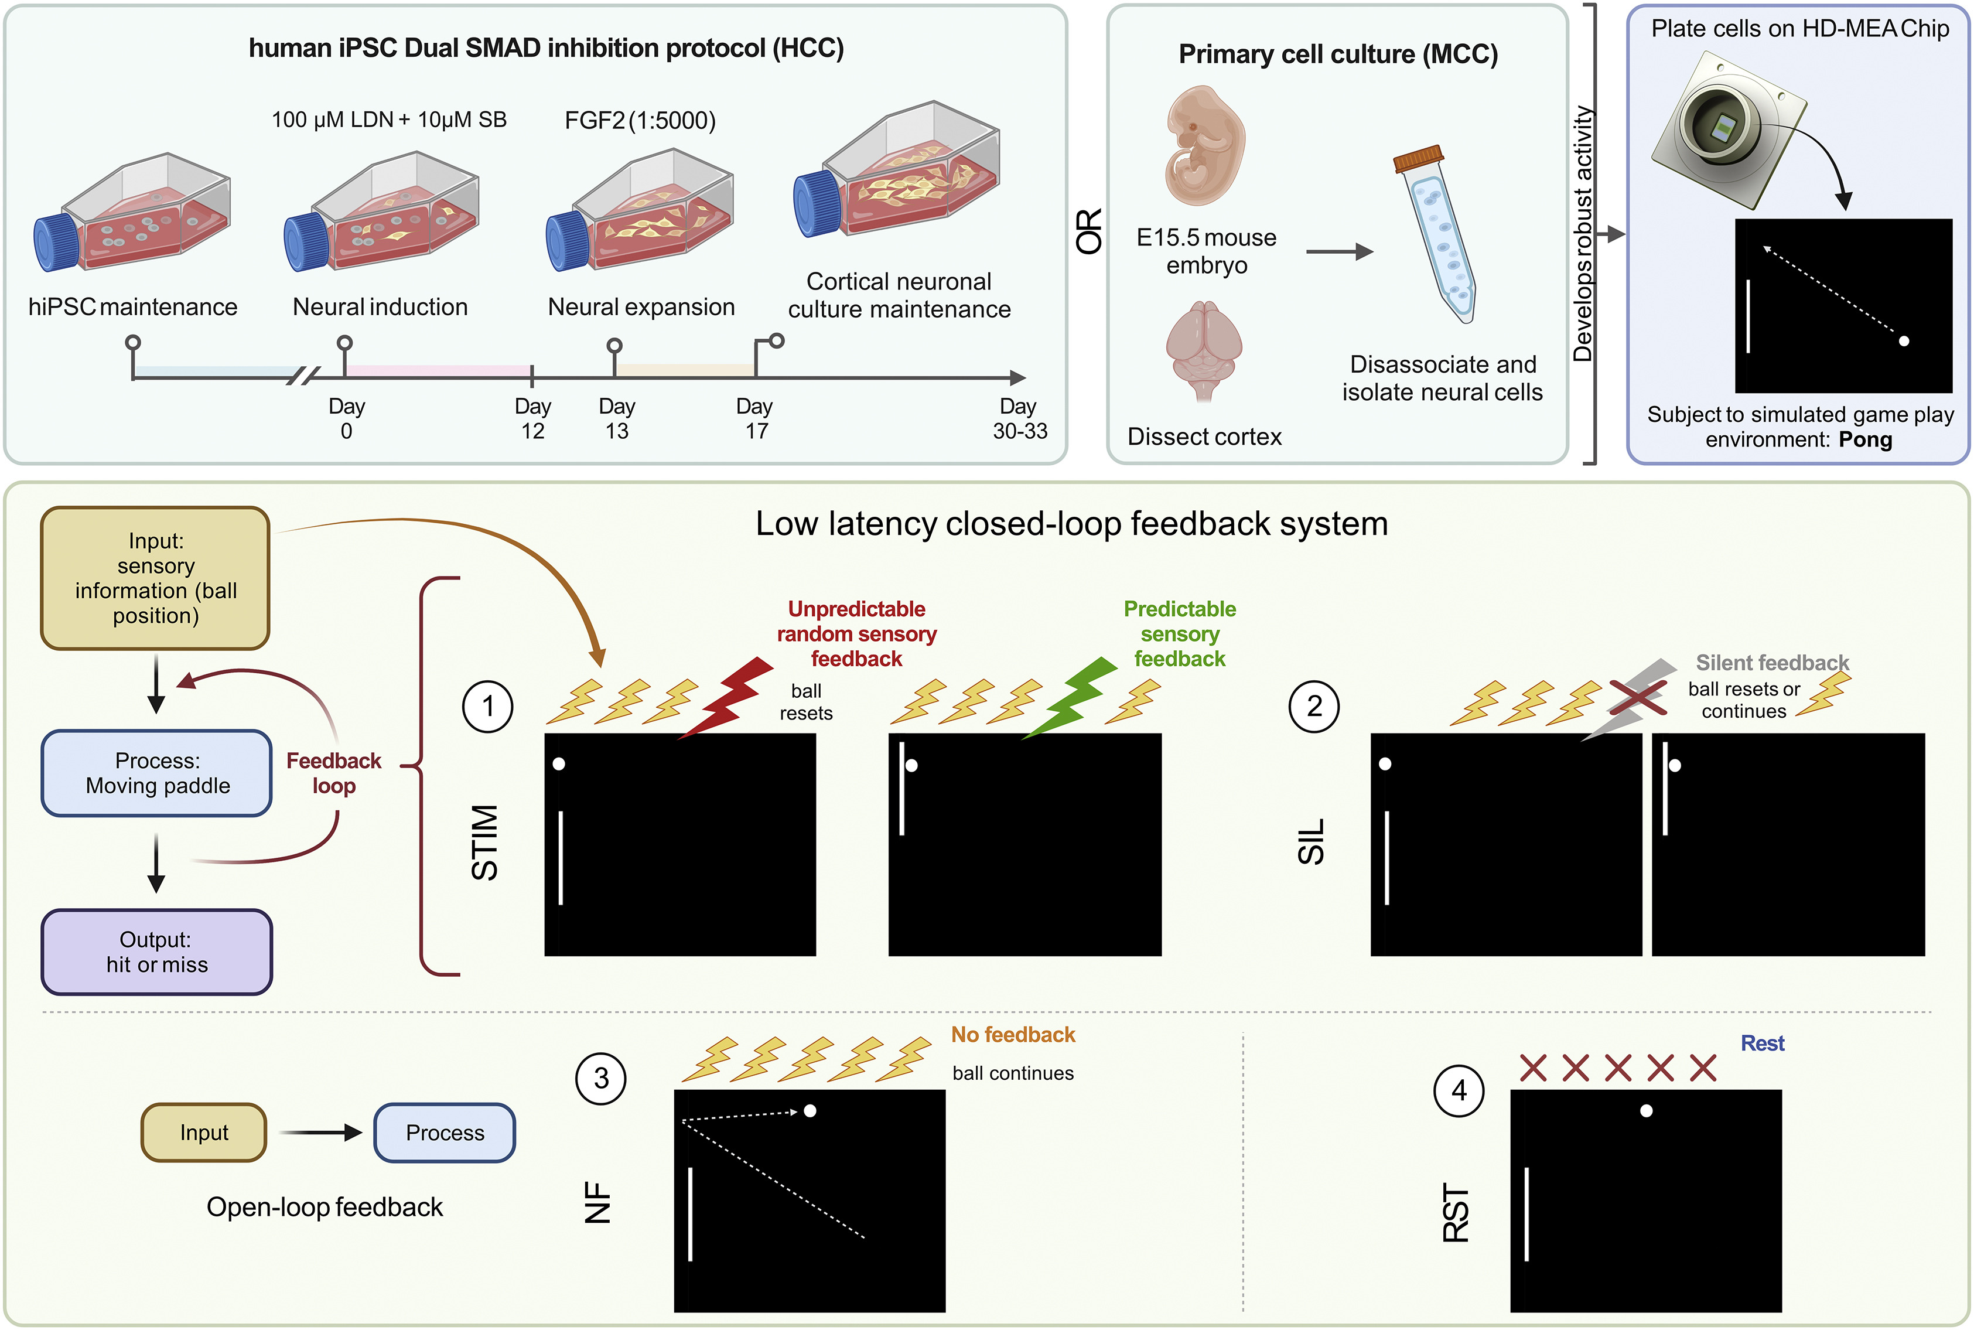
Figure 1
Neuron DOI: (10.1016/j.neuron.2022.09.001)
Copyright © 2022 The Author(s) Terms and Conditions
Notes:
DishBrain system and experimental protocol schematic
Neuronal cultures derived from hiPSC via DSI protocol, NGN2 lentivirus-directed differentiation, or primary cortical cells from E15.5 mouse embryos were plated onto HD-MEA chips and embedded in a stimulated game-world of “Pong” via the DishBrain system. Different DishBrain environments were created by altering the pattern of sensory information (yellow bolts), feedback (colored bolts), or no stimulus (red crosses) to demonstrate (1 and 2) low-latency, closed-loop feedback system (stimulation (STIM) and silent (SIL) treatment); (3) no-feedback (NF) system to demonstrate an open-loop feedback configuration; and (4) rest (RST) configuration to demonstrate a system in which sensory information is absent. Interactive visualizer of activity and gameplay: https://bit.ly/3DSi4Eg.

