Slide 1
Weight Loss Clinic Dubai
Our clinic also provides weight-loss treatment plans: we have the best range of surgical, non-surgical and diet plans. We are offering our services at significantly less cost. Our clinic is recognised as one of the Best Weight Loss Clinic Dubai. If you desire to lose weight effectively without any discomfort, consider visiting our clinic. We are here to provide our quality services, as our patients prefer.

Slide 2
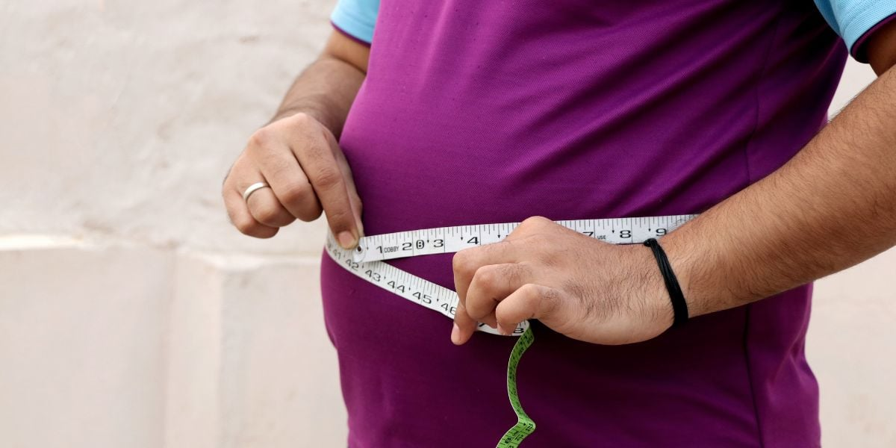
Weight Loss Clinic Dubai

Slide 3
Weight Loss Clinic Dubai
Maintaining a healthy weight is crucial for a happy and fulfilling life. However, with our busy lifestyles and easy access to unhealthy food options, it can be challenging to maintain a healthy weight.
This is where Weight Loss Clinic Dubai comes in - we offer personalized weight loss programs that help you achieve your weight loss goals in a safe and sustainable way. In this article, we'll take a closer look at our clinic and how we can help you achieve your weight loss goals.
Why Choose Weight Loss Clinic Dubai for Your Weight Loss Journey?
At Weight Loss Clinic Dubai, we understand that every individual is unique, and there is no one-size-fits-all approach to weight loss Dubai.
That's why we offer personalized weight loss programs tailored to your individual needs and goals. Our programs are designed to help you achieve your weight loss goals in a safe and sustainable way.

Slide 4
Weight Loss Clinic Dubai
Our Expert Team:
Our team of weight loss experts is dedicated to helping you achieve your weight loss goals. Our team includes certified nutritionists, fitness experts, and medical professionals who work together to create a personalized weight loss program that suits your individual needs and goals. We believe in a holistic approach to weight loss that focuses on nutrition, physical activity, and mental well-being.
Our Customized Weight Loss Programs:
At Best Weight Loss Clinic Dubai, we offer customized weight loss programs that are tailored to your individual needs and goals. Our programs are designed to help you lose weight in a safe and sustainable way. We use a combination of nutritional counseling, physical activity, and medical supervision to help you achieve your weight loss goals.

Slide 5
Contact Us
Address: Villa 1091, Al Wasl Road, Al Manara Area (On the junction of AlThanya & Al Wasl Road) Dubai
Mobile: 971 561772998
Website: www.dynamiclinic.com

