Slide 1
General Surgery in Dubai
Now avail the General Surgery in Dubai in the way done under one roof in the dynamic clinic Dubai. It offers a wide range of surgeries done by some astounding surgeons"

Slide 2
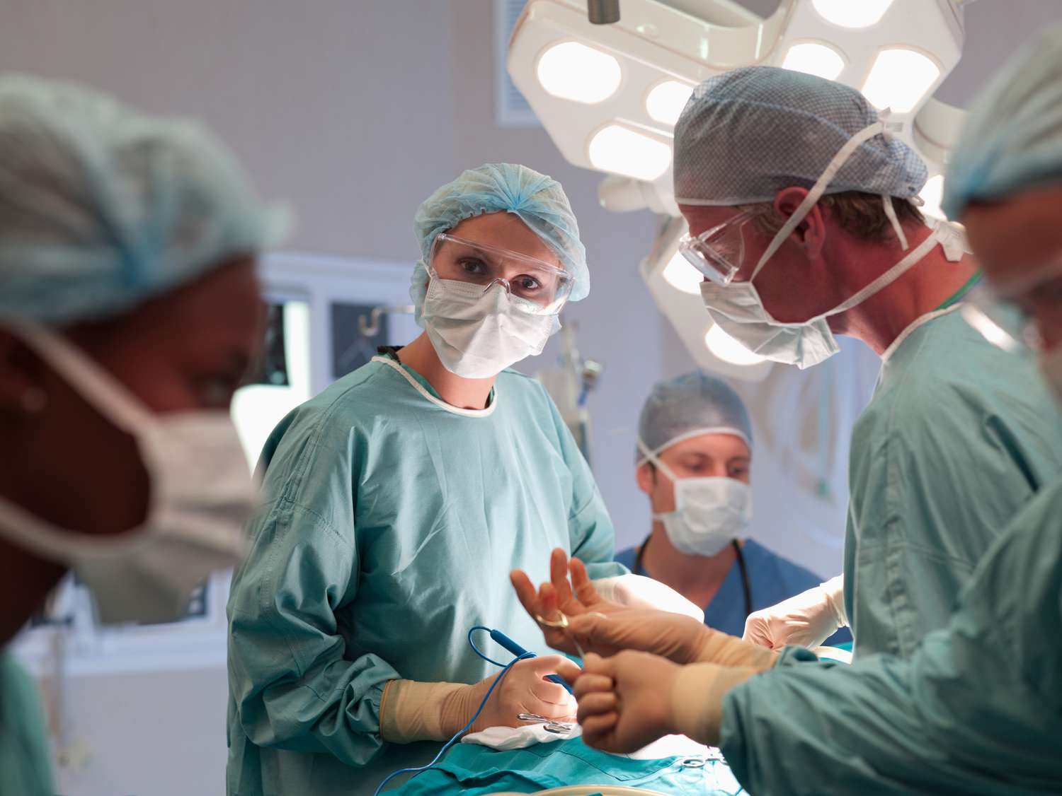
General Surgery in Dubai

Slide 3
General Surgery in Dubai
Dubai has become a popular destination for medical tourism in recent years, thanks to its advanced healthcare infrastructure and world-class facilities. One of the most sought-after specialties in the emirate is general surgery, which encompasses a wide range of surgical procedures for various conditions. In this article, we will provide a comprehensive overview of General Surgery in Dubai, covering the services, facilities, and procedures available for patients seeking surgical care.
Introduction: Understanding General Surgery and Its Importance
Before we dive into the details of general surgery in Dubai, it is important to understand what this specialty entails and why it is essential for patients. General surgery refers to the branch of medicine that deals with the diagnosis, treatment, and management of surgical conditions affecting the abdomen, chest, and other parts of the body. This includes procedures such as appendectomy, hernia repair, gallbladder surgery, and more.

Slide 4
General Surgery in Dubai
General surgery is a critical component of healthcare as it addresses conditions that cannot be treated with medication or non-invasive therapies. Surgical interventions are often necessary to remove tumors, repair injuries, or address other structural abnormalities that may pose a risk to a patient's health. In Dubai, general surgery is a well-established specialty with a wide range of services and facilities available to patients.
Services Offered by General Surgeons in Dubai
General surgeons in Dubai offer a range of services that cater to different patient needs. These services include:
Diagnosis and Evaluation
Before any surgical procedure, a general surgeon will perform a thorough evaluation of the patient's condition to determine the best course of treatment.

Slide 5
Contact Us
Address: Villa 1091, Al Wasl Road, Al Manara Area (On the junction of AlThanya & Al Wasl Road) Dubai
Mobile: 971 561772998
Website: www.dynamiclinic.com

