Slide 1
Gastric Balloon in Dubai
It is a minimally invasive procedure that helps individuals lose weight. In this procedure, the surgeon places a silicone balloon in the stomach. He then inflates the Gastric Balloon in Dubai with the saline solution. This Inflation occupies the space in the stomach and decreases the appetite of the person. It also makes the person fuller sooner. However, the doctors ask the patient to continue the diet and exercise with this procedure. The balloon lasts for six months or more in the stomach.

Slide 2
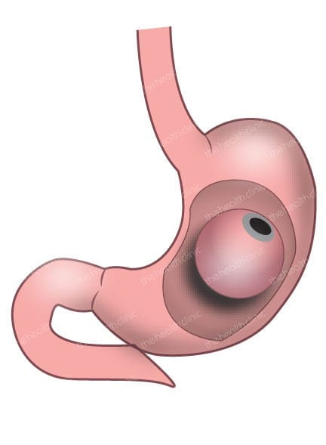
Gastric Balloon in Dubai

Slide 3
Gastric Balloon in Dubai
Are you struggling with excess weight and looking for a non-surgical and effective weight loss solution? Elipse Gastric Balloon might be the answer for you. This innovative procedure has gained popularity in Dubai as a safe and convenient option for achieving significant weight loss without the need for surgery.
In this article, we will explore the benefits, mechanism of action, eligibility, procedure details, recovery, cost, availability, testimonials, and frequently asked questions about Elipse Gastric Balloon in Dubai.
Benefits of Elipse Gastric Balloon
Elipse Gastric Balloon in Dubai offers several benefits as a weight loss solution. Firstly, it is a non-surgical procedure, which means that it does not require any incisions or invasive techniques.
This can be a preferred option for individuals who are not suitable candidates for weight loss surgery or those who prefer a less invasive approach. The absence of surgery also means that the risks of complications, such as infections and scarring, are minimal.

Slide 4
Gastric Balloon in Dubai
Another benefit of Elipse Gastric Balloon is its short procedure time and quick recovery. The entire procedure can usually be completed in less than 30 minutes, and patients can usually resume their normal activities shortly after the procedure.
This makes it a convenient option for individuals with busy lifestyles or limited time for recovery.
Elipse Gastric Balloon in Dubai is also customizable and adjustable to individual needs. The balloon can be filled with different amounts of fluid, allowing for personalized adjustments based on the patient's weight loss goals and progress.
This flexibility makes it possible to achieve significant weight loss while minimizing discomfort or side effects.

Slide 5
Contact Us
Address: Villa 1091, Al Wasl Road, Al Manara Area (On the junction of AlThanya & Al Wasl Road) Dubai
Mobile: 971 561772998
Website: www.dynamiclinic.com

