Slide 1
Laparoscopic Surgery Dubai
When people hear the word surgery they tend to get scared and nervous about it. Fortunately, science had made so many advancements that now the Laparoscopic Surgery in Dubai can help a doctor carry out a procedure effectively as it is minimally invasive and causes less damage to the body. Head to Dynamic Clinic today and get all the information you need about the procedure.

Slide 2
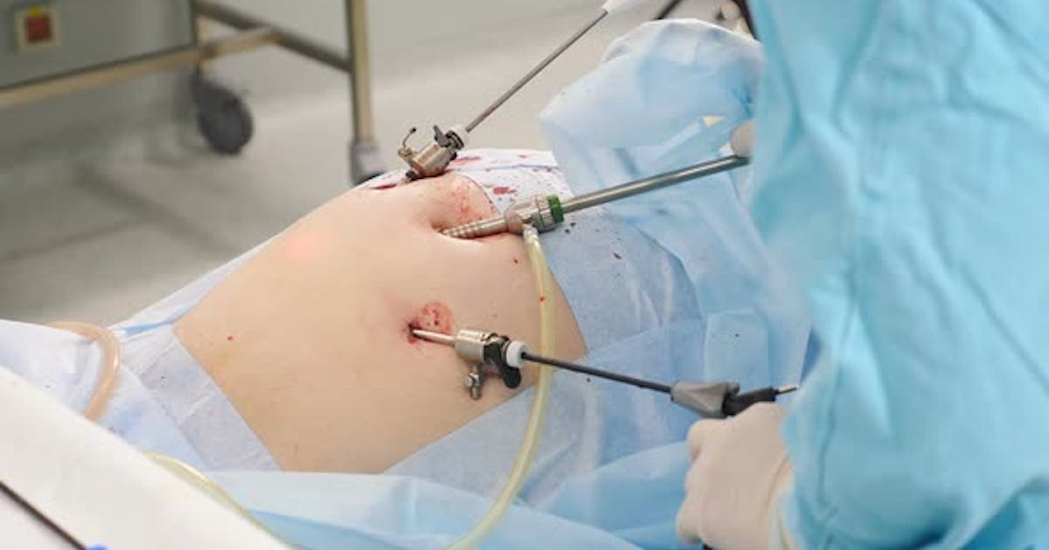
Laparoscopic Surgery Dubai

Slide 3
Laparoscopic Surgery Dubai
Are you looking for an alternative to traditional surgery that is less invasive, less painful, and allows for a quicker recovery time? If so, you may want to consider laparoscopic surgery in Dubai. In this article, we will discuss the benefits, procedures, and cost of laparoscopic surgery in Dubai.
What is laparoscopic surgery?
Laparoscopic surgery, also known as minimally invasive surgery, is a surgical technique that uses small incisions in the abdomen to insert a laparoscope, a thin tube with a camera and a light source, and other surgical instruments to perform a surgery. The camera provides a view of the internal organs on a monitor, allowing the surgeon to perform the surgery without making a large incision.
Advantages of laparoscopic surgery
Laparoscopic surgery offers several advantages over traditional surgery, including:
Smaller incisions and less scarring
Less pain and discomfort
Shorter hospital stay
Quicker recovery time
Lower risk of infection and other complications
Higher precision and accuracy

Slide 4
Laparoscopic Surgery Dubai
Types of laparoscopic surgery
Laparoscopic surgery can be used to perform a variety of surgical procedures, including:
Gallbladder removal
Hernia repair
Appendectomy
Colorectal surgery
Preparation for laparoscopic surgery
Before undergoing laparoscopic surgery, you will need to prepare by:
Meeting with your surgeon to discuss the procedure and any risks or complications
Having a physical exam and any necessary tests, such as blood tests or imaging tests
Fasting for a certain period of time before the surgery
Stopping any medications or supplements that may interfere with the surgery or the anesthesia
Arranging for someone to take you home after the surgery

Slide 5
Contact Us
Address: Villa 1091, Al Wasl Road, Al Manara Area (On the junction of AlThanya & Al Wasl Road) Dubai
Mobile: 971 561772998
Website: www.dynamiclinic.com

