Slide 1
Gastric Sleeve Surgery in Dubai
Gastric Sleeve Surgery in Dubai is a special type of bariatric surgery in which size of the stomach is reduced. The amount of food a person can consume is reduced to 100 ml per intake.

Slide 2
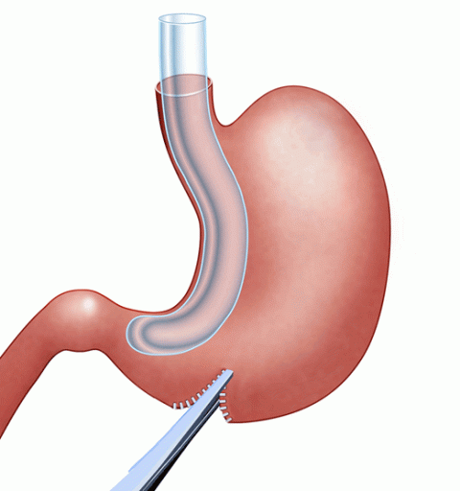
Gastric Sleeve Surgery in Dubai

Slide 3
Gastric Sleeve Surgery in Dubai
If you are struggling with obesity and looking for an effective weight loss solution, you may have come across gastric sleeve surgery. Also known as sleeve gastrectomy, this procedure involves reducing the size of the stomach and limiting the amount of food it can hold.
Dubai has become a popular destination for medical tourism, and many people are considering gastric sleeve surgery in the city. In this article, we will explore everything you need to know about Gastric Sleeve Surgery in Dubai.
What is Gastric Sleeve Surgery?
Gastric sleeve surgery is a weight loss surgery that involves the removal of a portion of the stomach. The remaining part of the stomach is reshaped into a narrow tube or sleeve shape.
The procedure is usually performed laparoscopically, which means small incisions are made in the abdomen, and a laparoscope (a tiny camera) is used to guide the surgeon. Gastric sleeve surgery is considered a safe and effective weight loss solution for people who are morbidly obese and have not been able to lose weight through diet and exercise.

Slide 4
Gastric Sleeve Surgery in Dubai
How Does Gastric Sleeve Surgery Work?
Gastric sleeve surgery works by reducing the size of the stomach, which in turn limits the amount of food a person can eat.
The procedure removes approximately 80% of the stomach, leaving behind a small, banana-shaped portion. This smaller stomach can hold only a small amount of food, which means the patient will feel full sooner and eat less.
Who is a Good Candidate for Gastric Sleeve Surgery?
Gastric sleeve surgery is generally recommended for people who have a body mass index (BMI) of 40 or higher. It may also be recommended for people with a BMI of 35 or higher if they have obesity-related health problems such as type 2 diabetes, high blood pressure, or sleep apnea. Candidates for gastric sleeve surgery should have tried and failed to lose weight through diet and exercise.

Slide 5
Contact Us
Address: Villa 1091, Al Wasl Road, Al Manara Area (On the junction of AlThanya & Al Wasl Road) Dubai
Mobile: 971 561772998
Website: www.dynamiclinic.com

