Slide 1
Understanding digital photography production
Digital Photography is a very widely used type of media that is used in many different ways by different people,

Slide 2
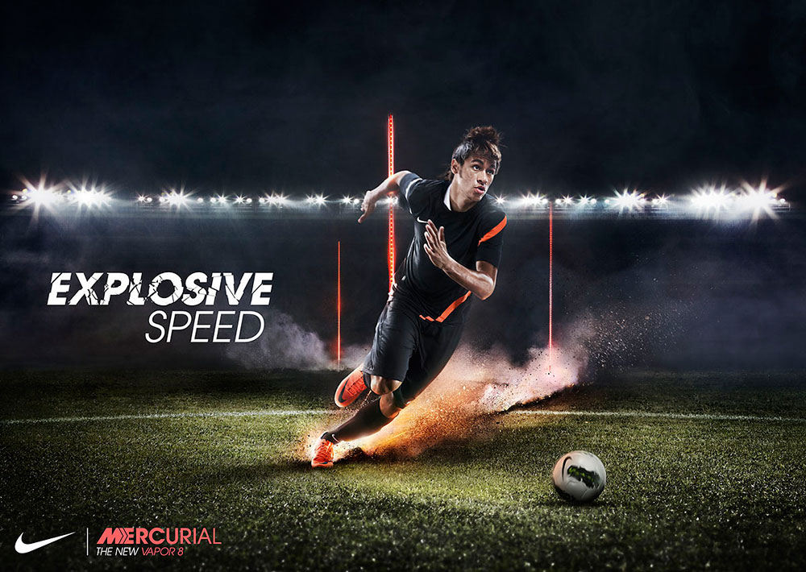
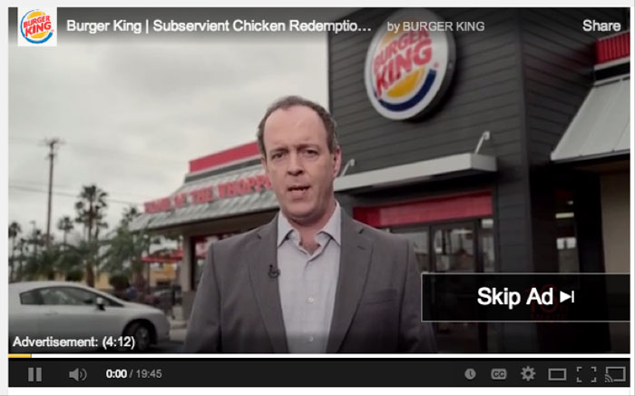
Advertising Photgrahy
Advertising is when companies try to influence potential customers into buying their products by using a persuading message about the product. Advertising is present in many different types of media. It is very commonplace in Newspapers and Magazines and other types like Social Media have also made space for advertising on their platforms.
An example of a Print Magazine Advert, most of these spread over two pages to ensure they are seen and read by the audience
An example of advertising on Social Media, because it is digital, videos can be loaded and played before allowing access to the video or image that the user wants to see, they can also be more interactive.

Slide 3
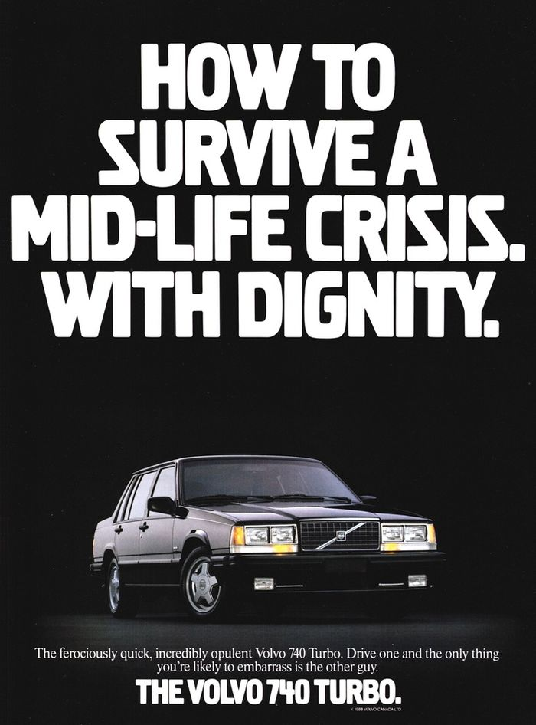
Purpose of Advertising
The main purpose of advertising is to persuade a user into buying a product or drawing people to your business, some advertisements also have customer reviews to persuade people to try the product as others have had positive experiences with them. Advertising can also be used to announce a new product or product line to an already growing company.
This advertisement was advertising a new car to a select audience in an attempt to have them consider this car over others

Slide 4
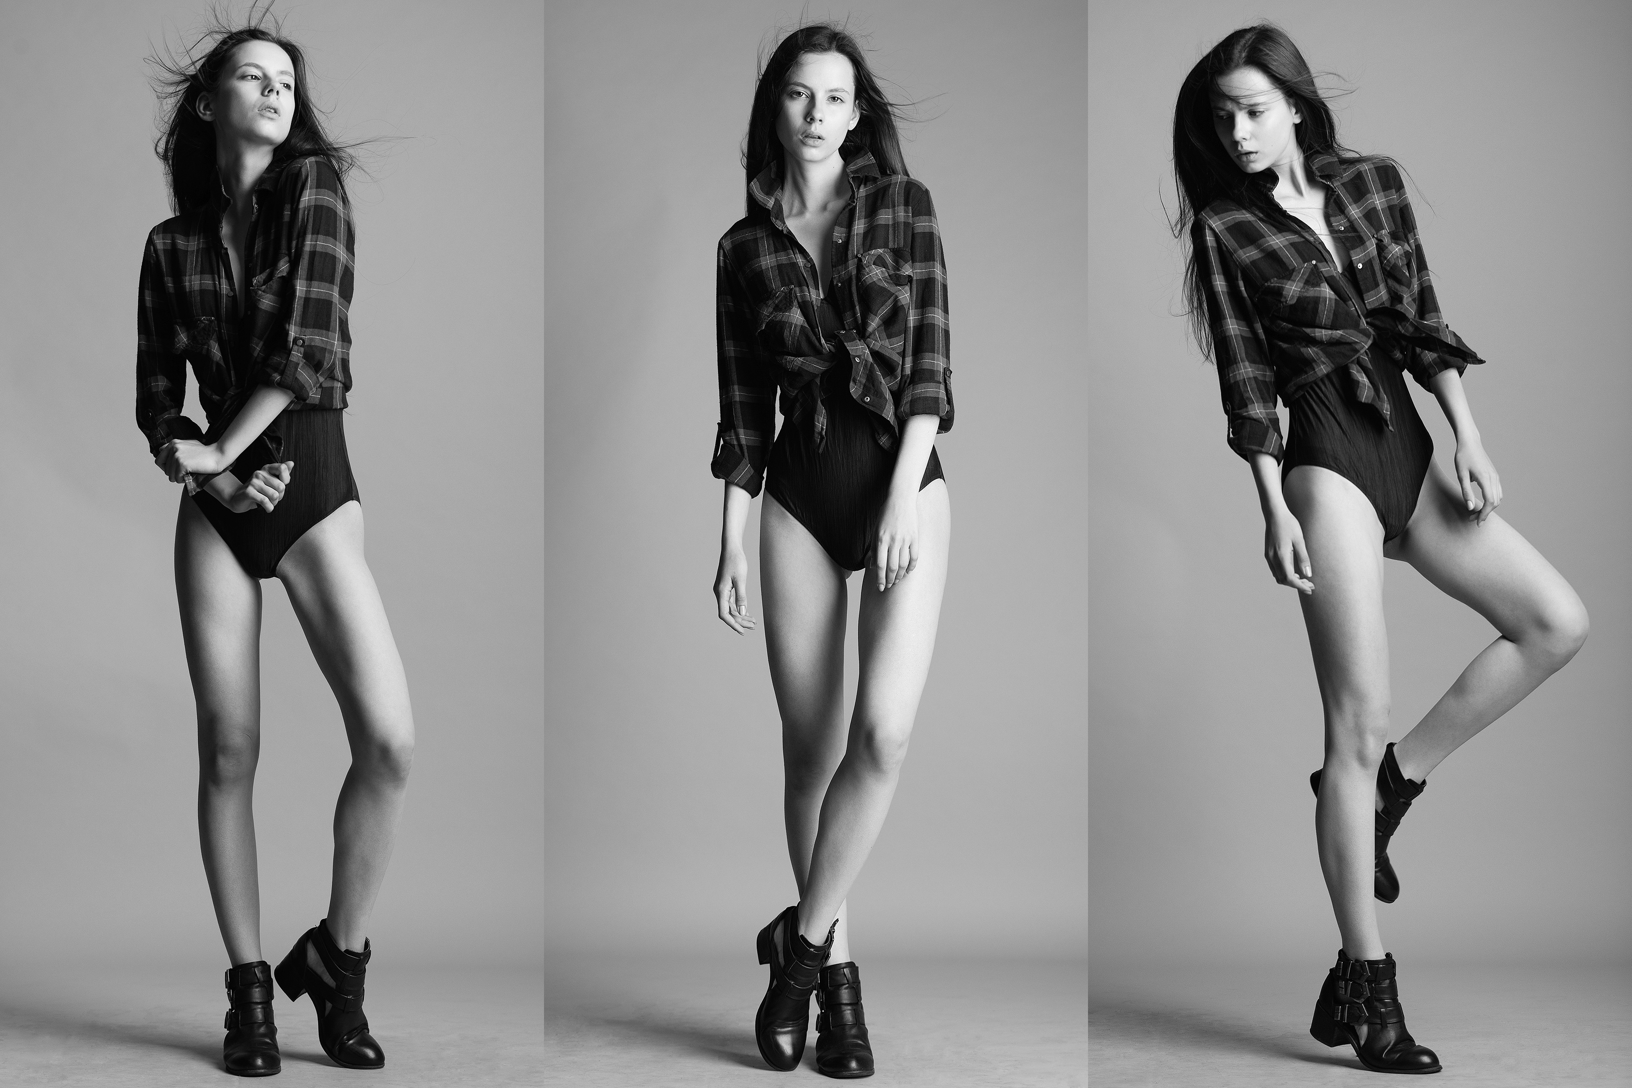
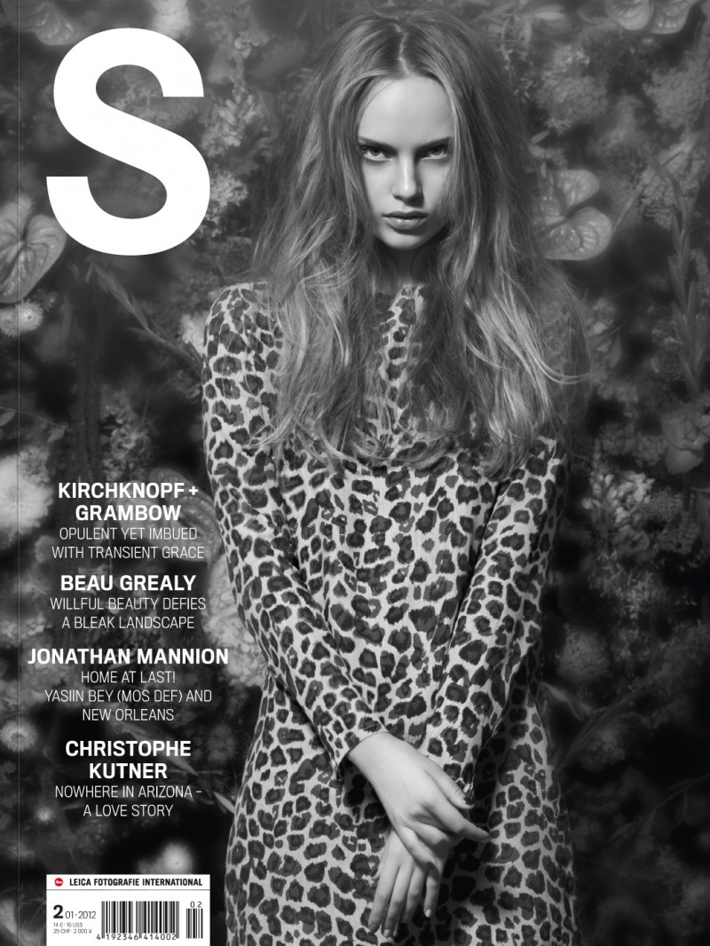
Fashion Photography
Fashion photography is a type of photography present in many media texts especially fashion magazines, the main focus of these photos are the models and the clothing they wear. This genre of photography is very creative in its mise-en-scene but the technical aspects of the photo are almost always the same. Typically, most Fashion photograph consists of a full body shot of a model wearing clothes, the shot is almost always at a straight angle with either a plain or very colourful background.

Slide 5
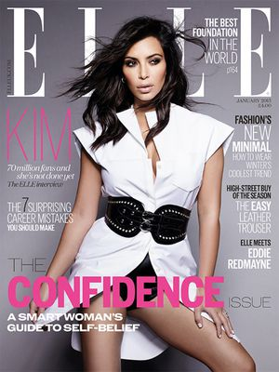
Purpose of Fashion
The purpose of fashion photography is to promote new trends in fashion and also provides a platform for fashion models to become more popular through these pictures. These Fashion photos promote new models and new trends in the fashion industry.
An example of a fashion magazine

Slide 6
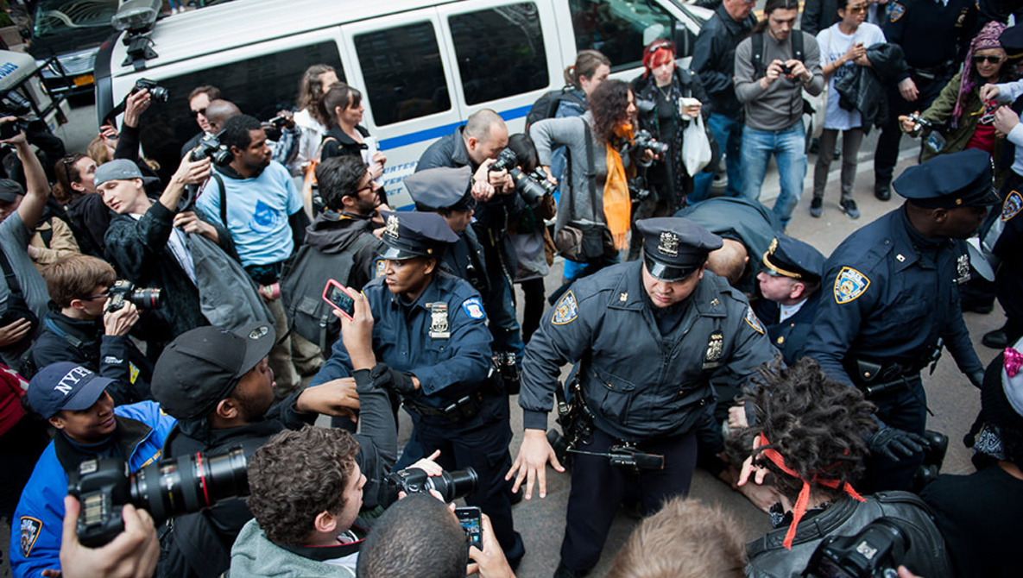
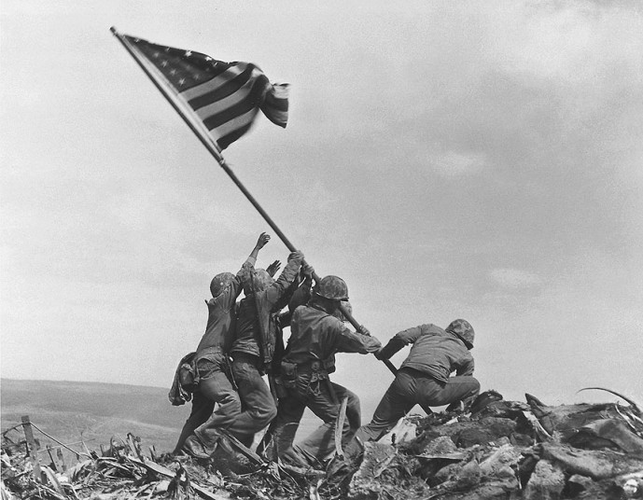
Photojournalism Photgraphy
Photojournalism is a type of photography that helps to communicate news and other information through photography. This type of photography is most commonly seen in newspapers and news magazines e.g Evening Standard and The Week Magazine.

Slide 7
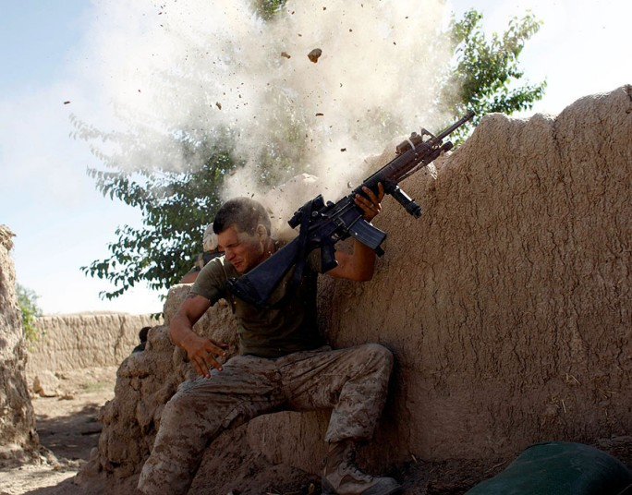
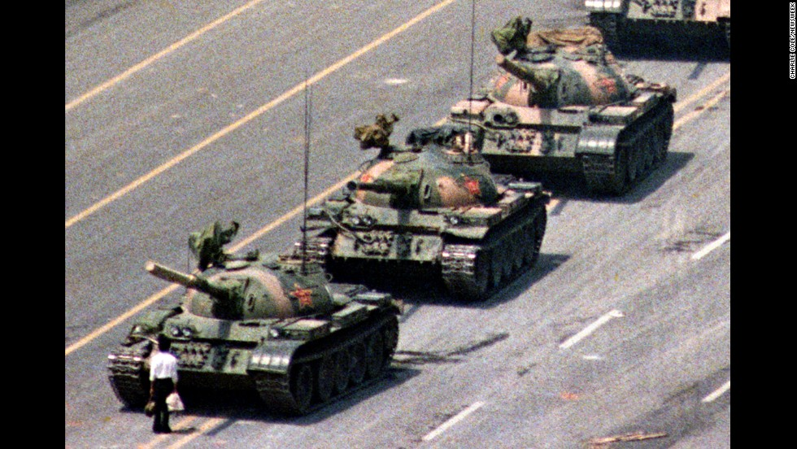
Purpose of Photojournalism photography
Photojournalism's purpose is to tell a story through images, as some people believe that an image of an event can tell a better story than words could, they can also help to add context to an article and make it more appealing to look at. Photos can also be used for a more emotional story to be told through images, this is very common in wartime reporting where the graphic imagery that is sometimes published makes the audience feel much more empathetic than if it was put into words.

