Slide 1
Download Free Books PDF
https://donnajeanbooks.com

Slide 2

In our world new technologies are developed every day, and more and more people prefer e-books instead of classic books from paper.

Slide 3

During 2014, amount of sales of the books in electronic format increased by more than 30%.

Slide 4

But why are electronic books so popular?

Slide 5
Books in PDF and EPUB have several advantages. Let’s look at some of them:
They are compact and potable. You can store hundreds and thousands of book in one small device. Furthermore, e-books are usually smaller and lighter than paper books.
Interface personalization. You can always change font type and size and customize e-book interface.
Additional features. Your device may support text search and hyperlinks.
Price of text. Great part of texts in electronic format is cheaper than their printed copies.
You can download books from corresponding websites whenever you have Internet connection.
Eco-friendly. You don’t have to use paper to read e-books.
Safety for asthmatics, allergy sufferers and people who are sensitive to home and paper dust.

Slide 6

Our site was created for all of you, who love to read books and want to keep up with the times.

Slide 7
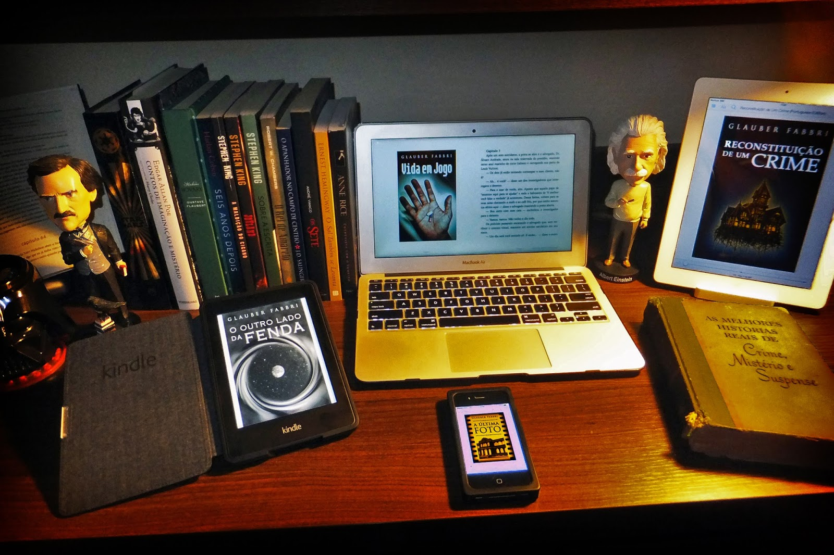
New books appear every day and our Donnajeanbooks.com website will help you to choose only best of them to download and read.

Slide 8

We conduct careful selection from wide variety of books before publishing it on our website, to save your time and make your life more efficient.

Slide 9
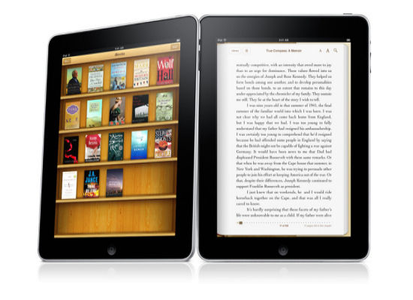
When you visit our website, you can always be sure that Donnajeanbooks.com team selected only best and new electronic books for you.

Slide 10
Don't hesitate and follow the link:
https://donnajeanbooks.com

