Slide 1
Air duct cleaning is a service that involves the cleaning and maintenance of the heating, ventilation, and air conditioning (HVAC) systems in residential and commercial buildings.

Slide 2
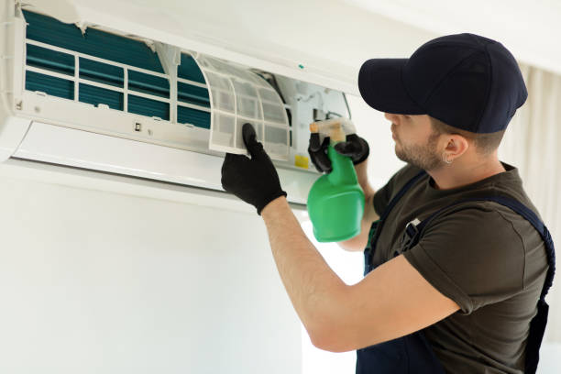
Improved Indoor Air Quality: Over time, dust, debris, allergens, and contaminants can accumulate in your HVAC system's air ducts.

Slide 3
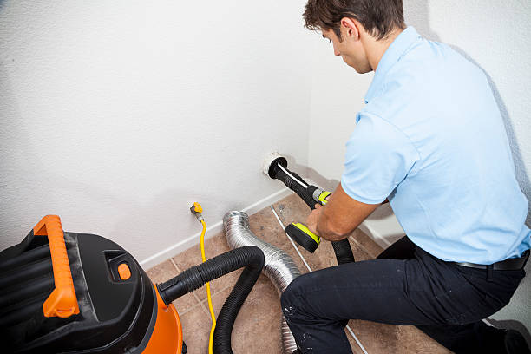
Health Benefits: Cleaner air can have positive effects on your health.

Slide 4
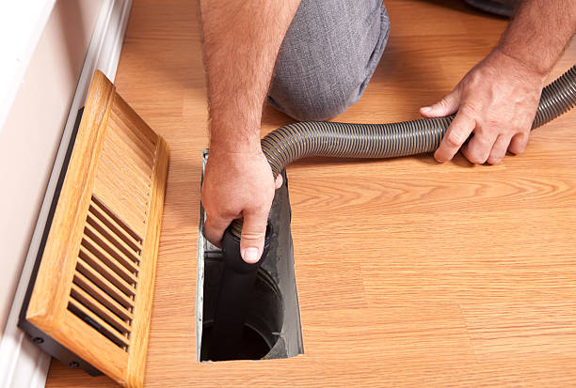
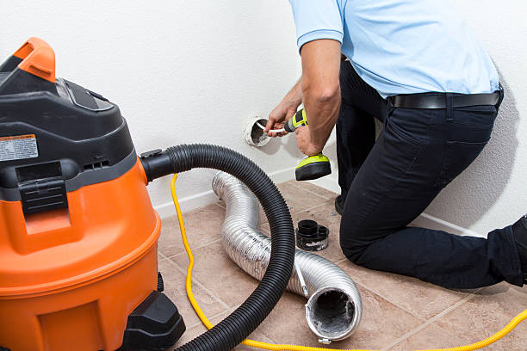
Energy Efficiency: A buildup of dust and debris in air ducts can restrict the airflow in the HVAC system.

Slide 5
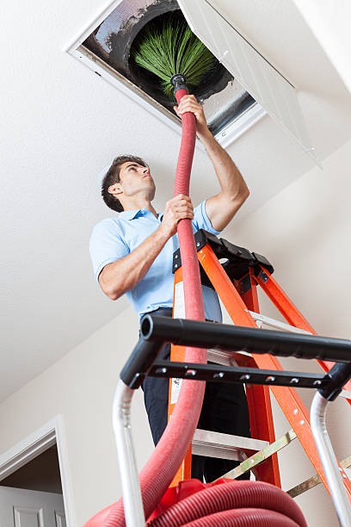
https://www.starducts.com/

