Slide 1
IDENTITY ON THE LINE
FINAL CONFERENCE
«The Migratory Experience: Adopting a three-generational Perspective»
Brussels, Norway House, 26th of April 2023
KATHRIN PABST, phD
Project leader //Vest-Agder Museum

Slide 2


IDENTITY ON THE LINE
A large-scale cooperation project between six cultural history museums and one university, working together to explore the long-term consequences of seven different migration processes, forced or voluntary, which took place in Europe over the last 100 years.
Through the collection and dissemination of experiences from former migrants and their descendants, summarised and placed in factual historical contexts, we will unfold and transmit common features of migration from past to future generations.
Our priority is to reinforce the sense of belonging to a common European space for contemporary migrants, to those who have settled and their hosting communities.
Project period: September 2019 – August 2023
Co-funded by the Creative Europe Program of the European Union with 1,28 Million Euro
Total budget: 2,56 Million Euro

Slide 3

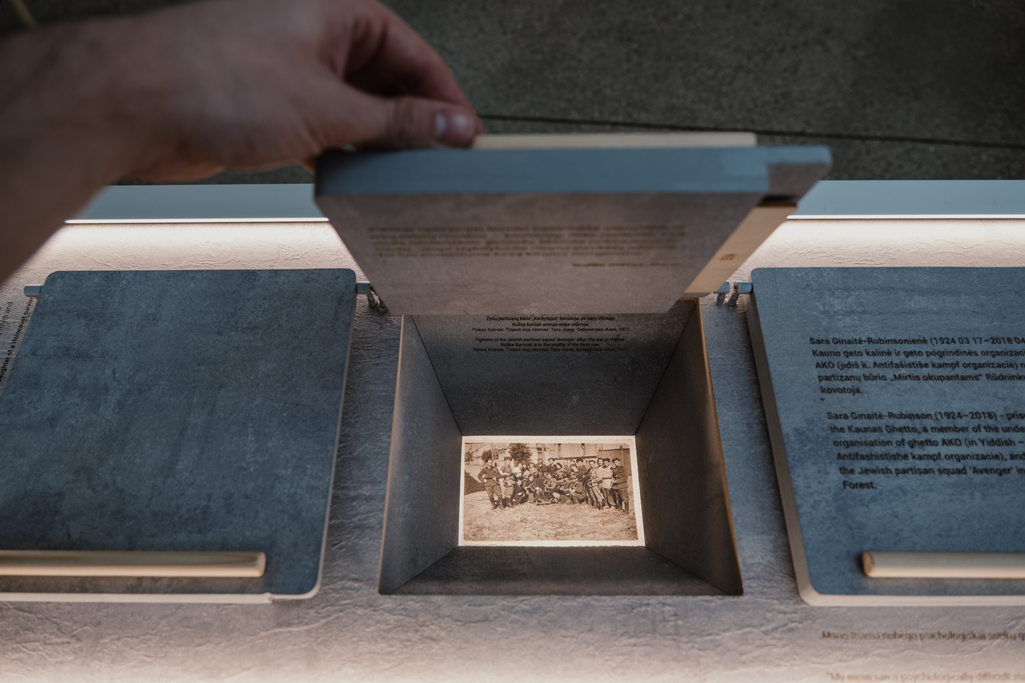
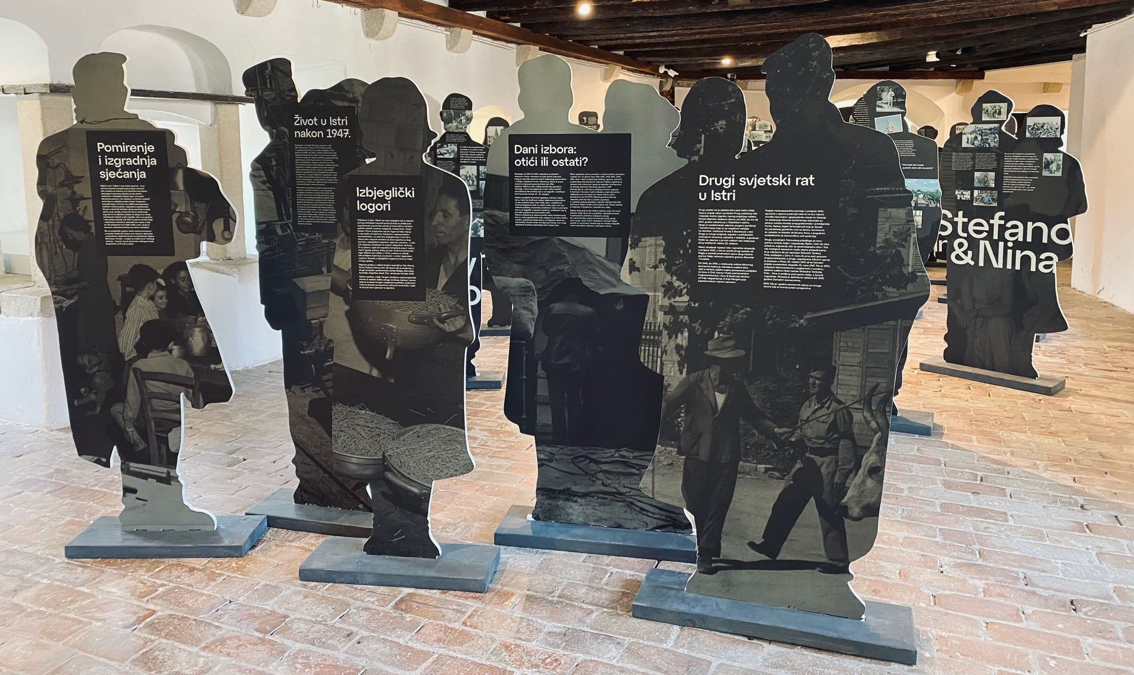
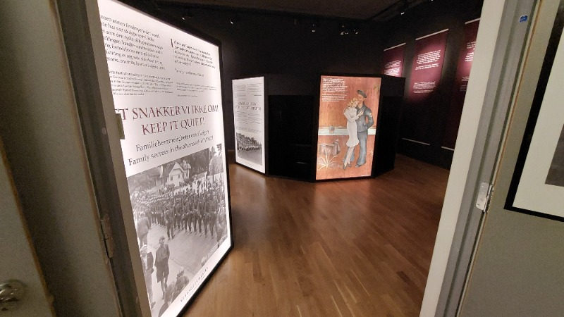
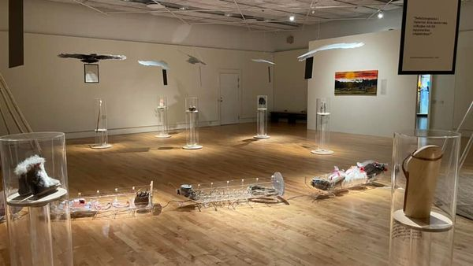
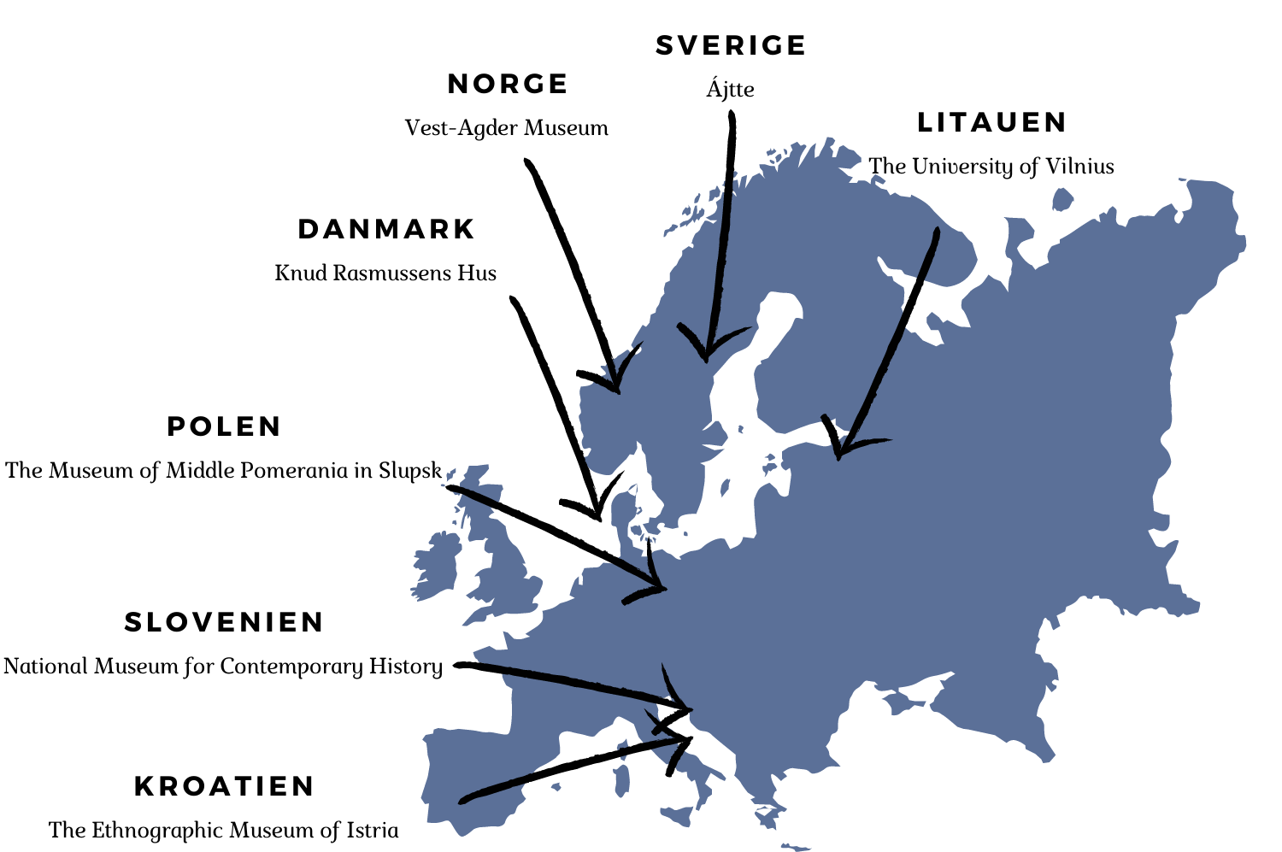
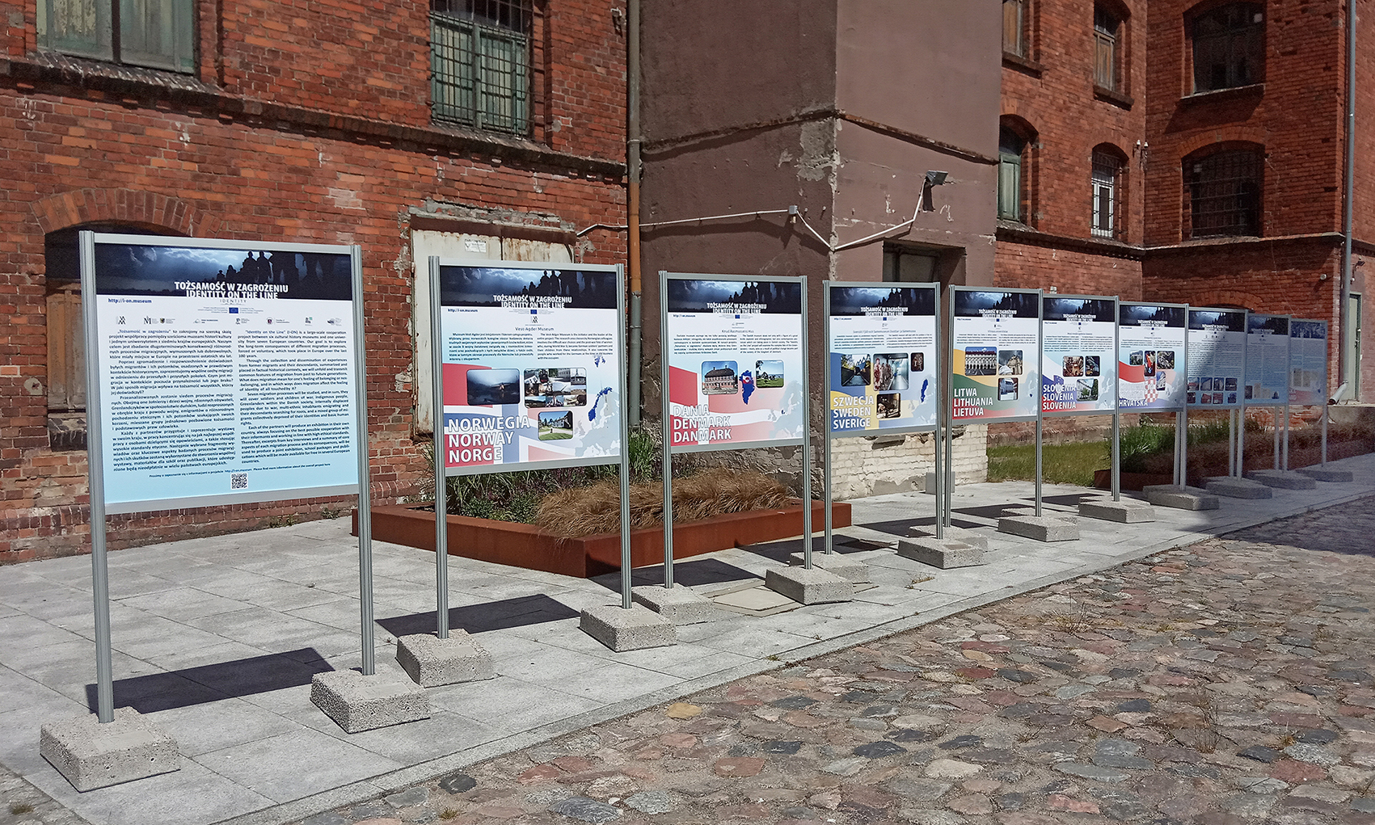
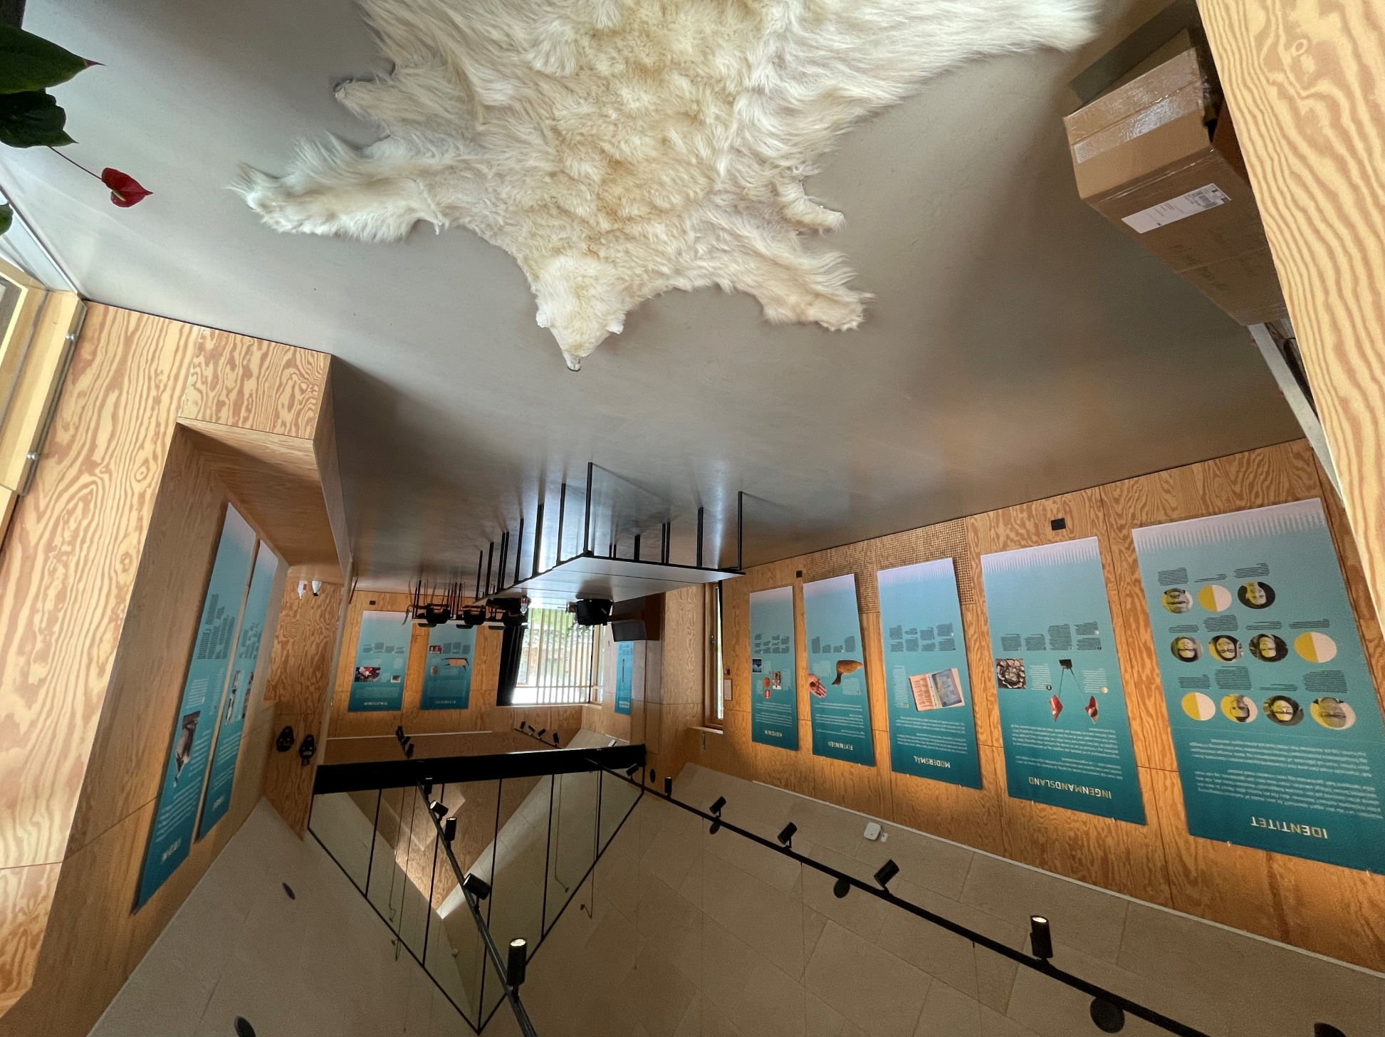
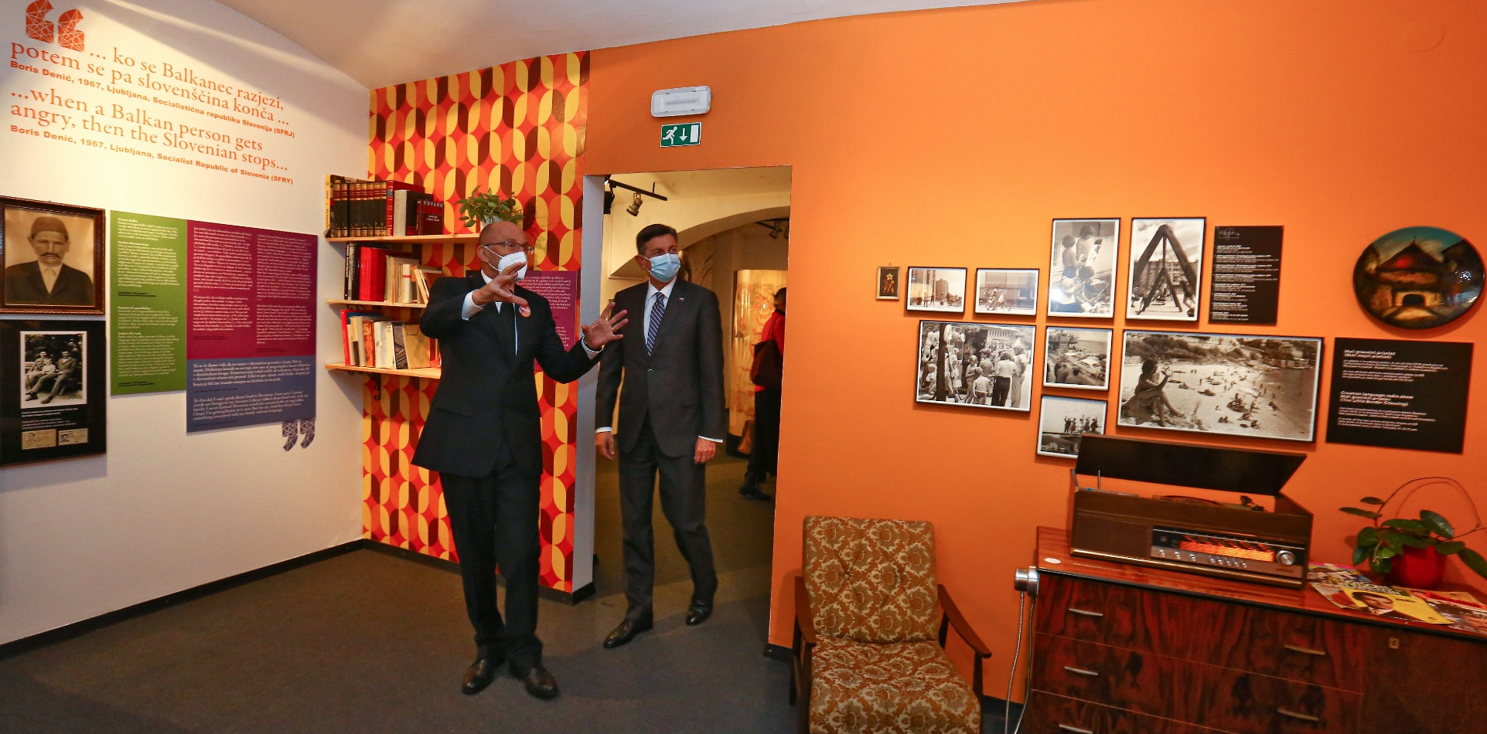
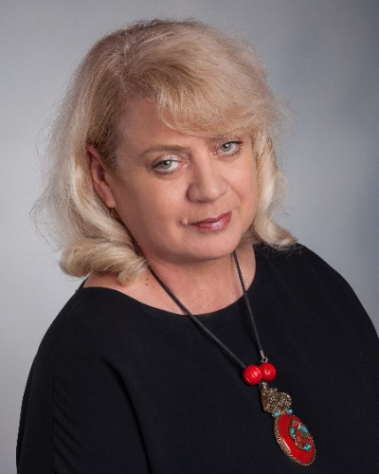
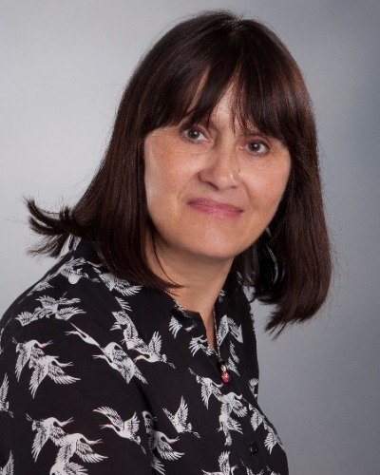
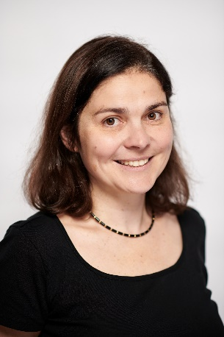

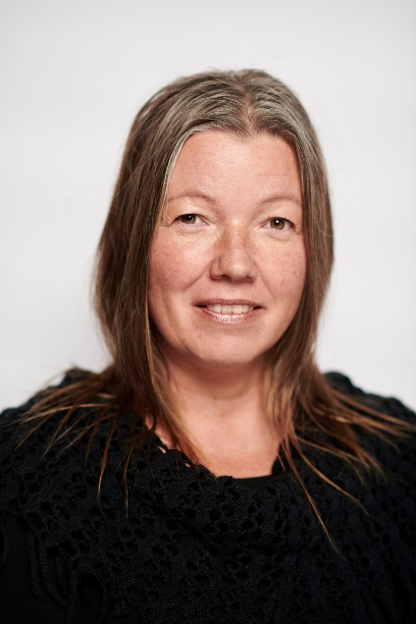

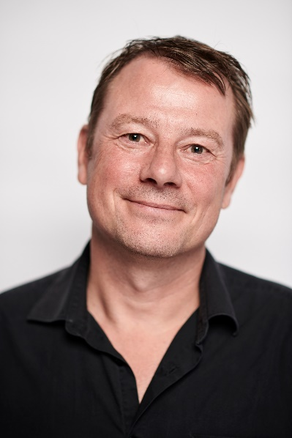


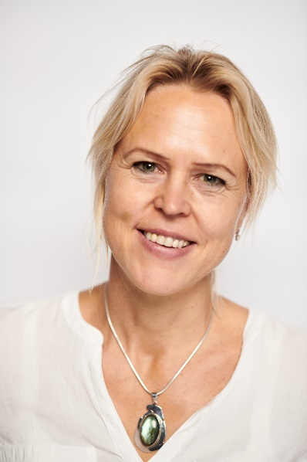
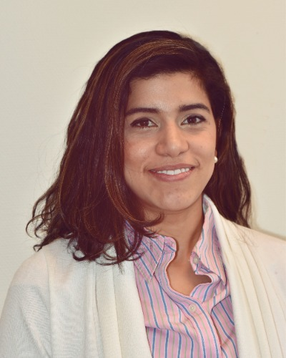
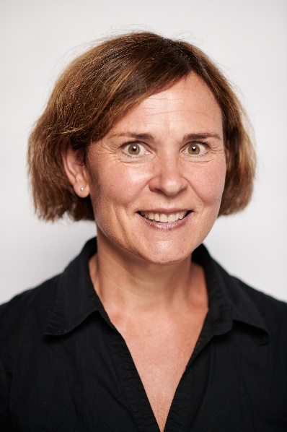
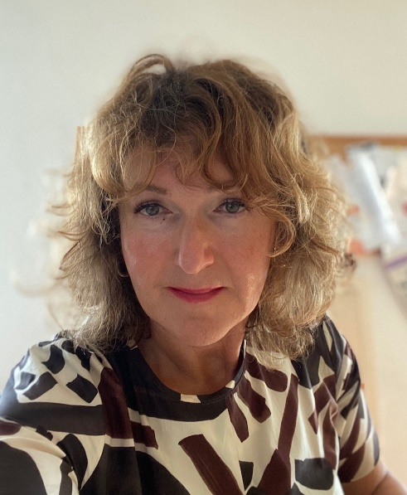


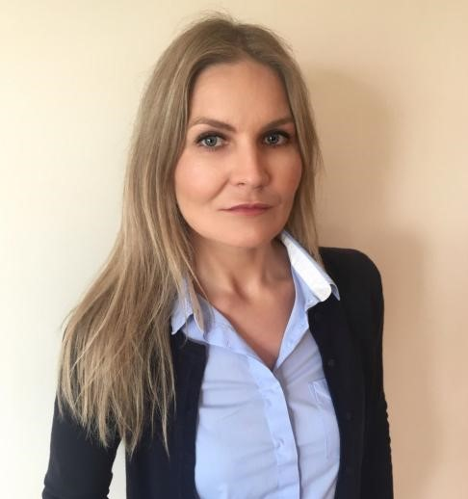

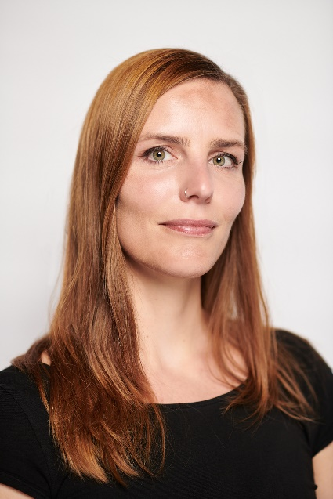
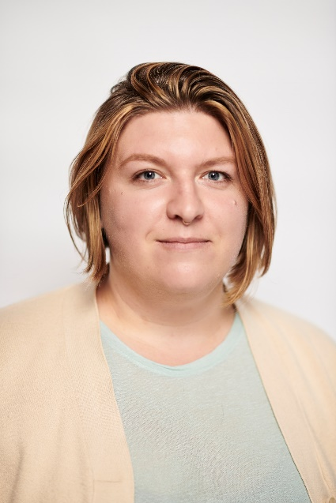



P4: POLAND: The Museum of Middel Pomerania
Population exchange in former German Pomerania after 1945, exemplified by Slupsk
P5: LITHUANIA: University of Vilnius
The long-term consequences of the Holocaust for Lithuanian women
P2: DENMARK: Knud Rasmussens Hus
The long-term consequences of the migration from Greenland to Denmark after 1945
P6: SLOVENIA: National Museum of Contemporary History
The migration from the former Yugoslav republics to Slovenia after World War II and the impact of the country's independence in 1991 on the migrants
P7: CROATIA: Ethnographic Museum of Istria
The complex political history of the Istrian peninsula and its multi-ethnic population related to 200 000 emigrants after World War II
P1: NORWAY: Vest-Agder Museum
The long-term consequences of the German occupation during World War II
P3: SWEDEN: Ajtte – Fjäll- och Samemuseum
Forced migration of Sámi from the North to the South of Sweden

Slide 4
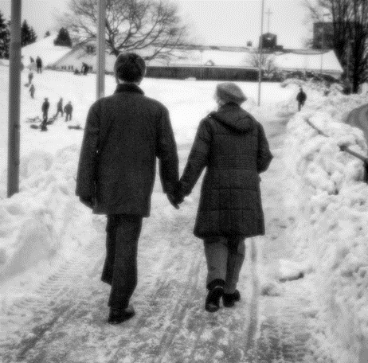

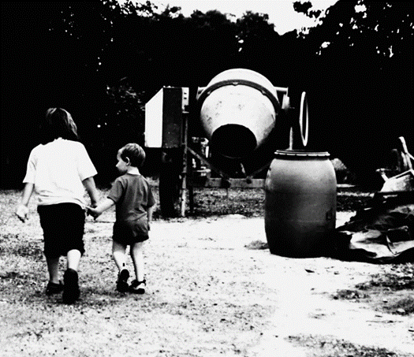
IDENTITY ON THE LINE
1st generation
2nd generation
3rd generation
In sum, 164 interviews were conducted, each 2 to 15 hours long.
62 quotes are presented in I-ONs joint exhibition.
All pictures: Anita Nilsen/Vest-Agder-museet

Slide 5
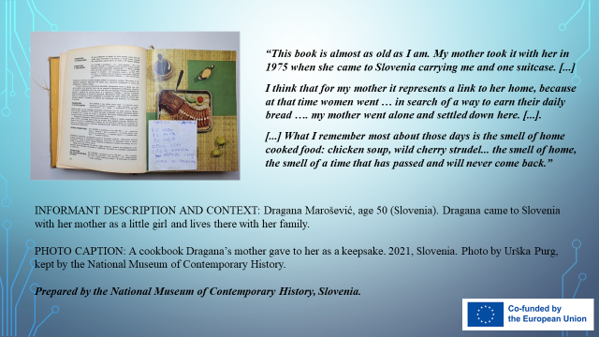
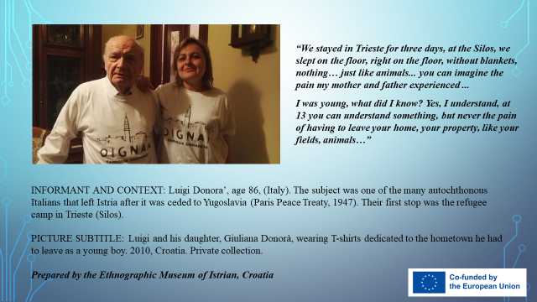
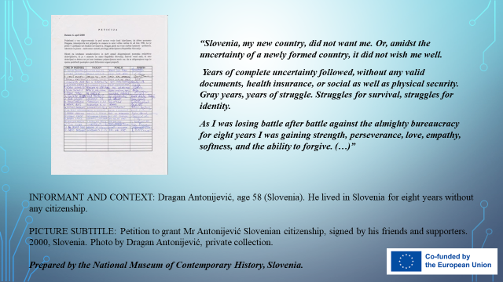
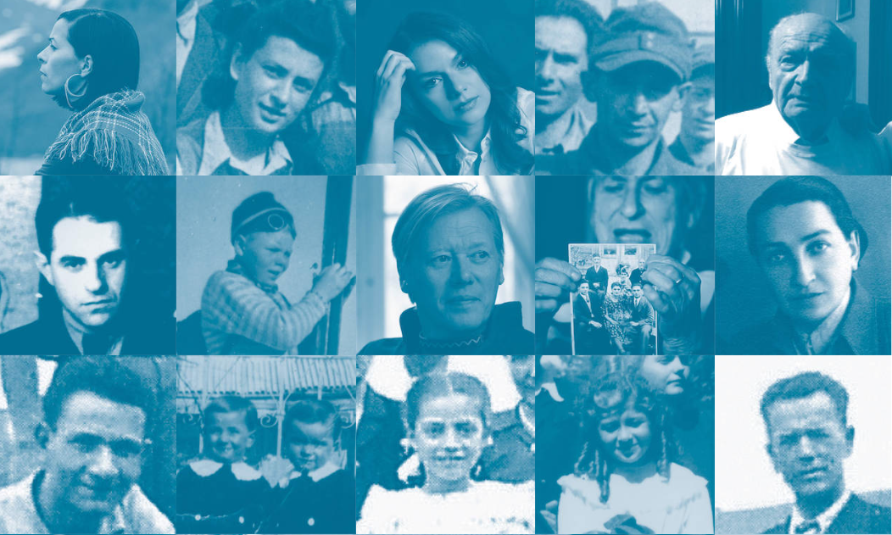
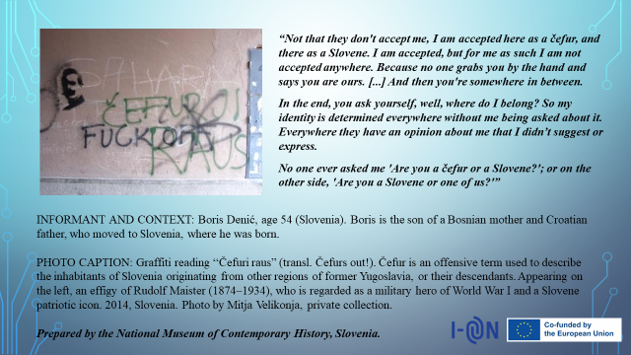
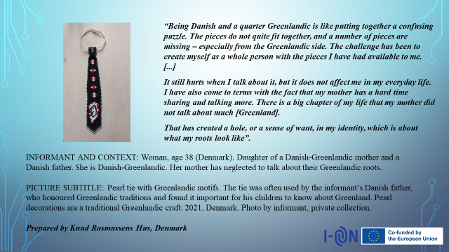
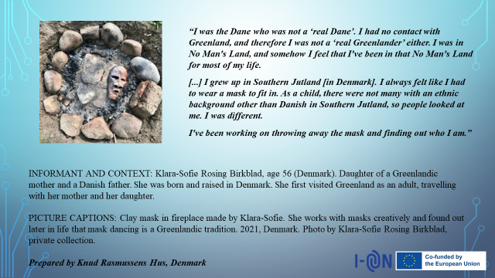
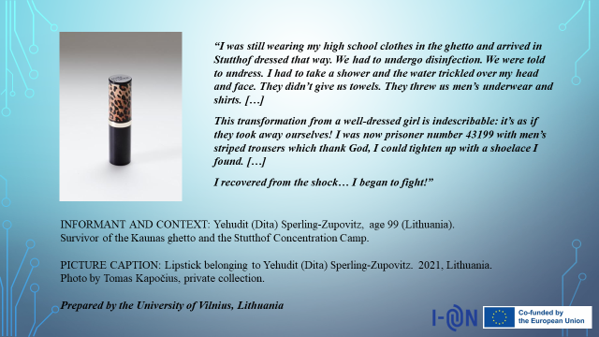
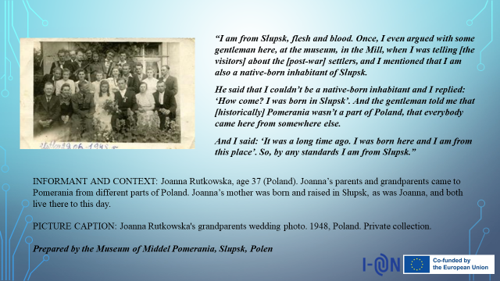
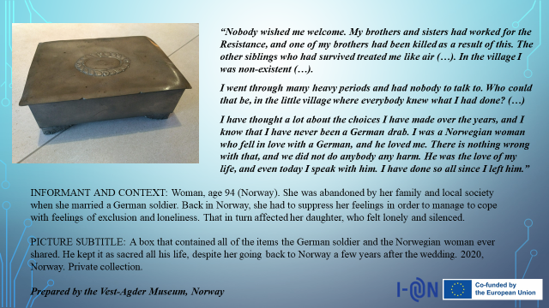
164 PERSONAL STORIES FROM
7 EUROPEAN COUNTRIES

Slide 6
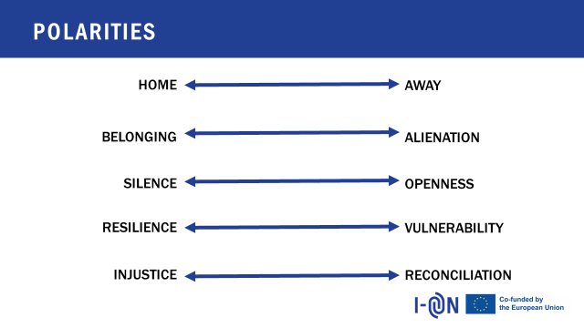
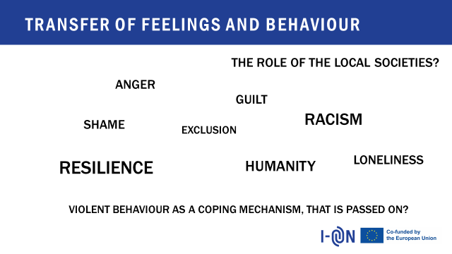
FINDING COMMON GROUNDS
SEVERAL EXHIBITION CATALOGUES
ONE ANTHOLOGY, 6 SCIENTIFIC ARTICLES

Slide 7

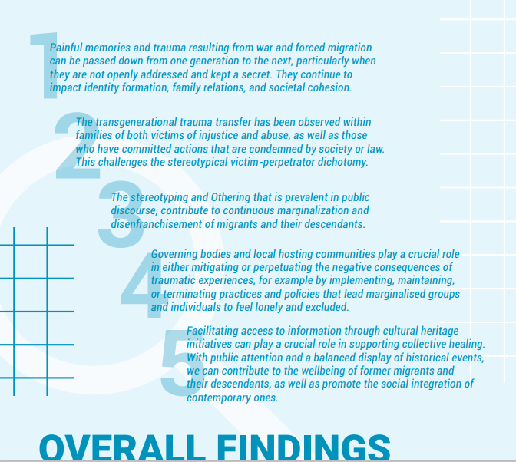
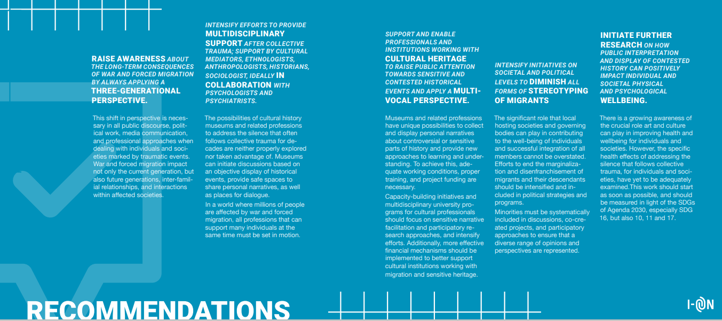
Findings
& Recommen-dations

Slide 8
Findings
1. Painful memories and trauma resulting from war and forced migration can be passed down from one generation to the next, particularly when they are not openly addressed and kept a secret. They continue to impact identity formation, family relations, and societal cohesion.
2. The transgenerational trauma transfer has been observed within families of both victims of injustice and abuse, as well as those who have committed actions that are condemned by society or law. This challenges the stereotypical victim-perpetrator dichotomy.
3. The stereotyping and Othering that is prevalent in public discourse, contribute to continuous marginalization and disenfranchisement of migrants and their descendants.
4. Governing bodies and local hosting communities play a crucial role in either mitigating or perpetuating the negative consequences of traumatic experiences, for example by implementing, maintaining, or terminating practices and policies that lead marginalised groups and individuals to feel lonely and excluded.
5. Facilitating access to information through cultural heritage initiatives can play a crucial role in supporting collective healing. Public attention and a balanced display of historical events, we can contribute to the wellbeing of former migrants and their descendants, as well as promote the social integration of contemporary ones.

Slide 9
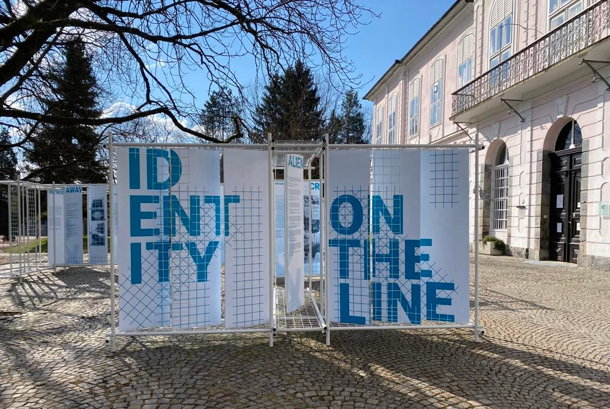
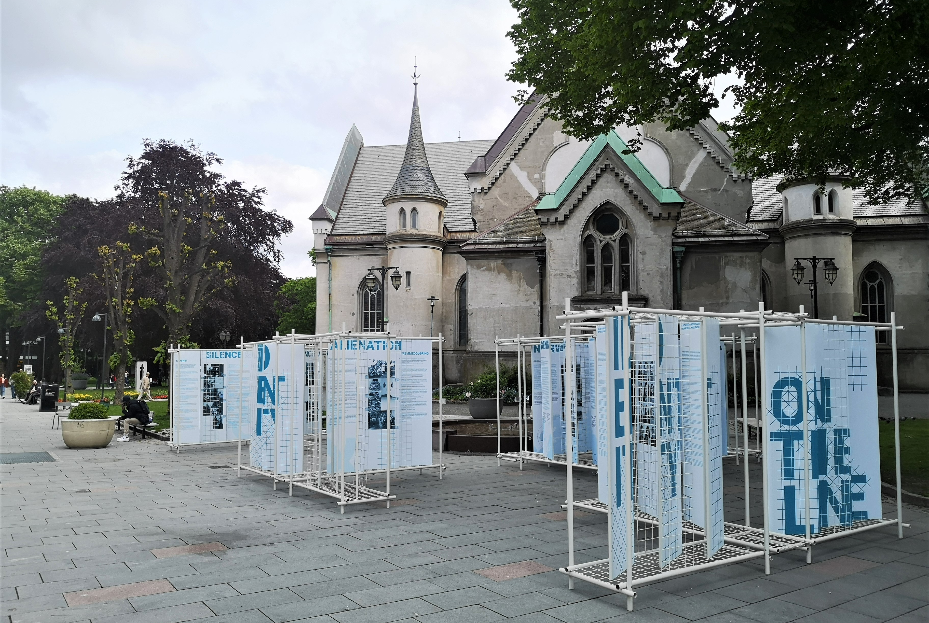
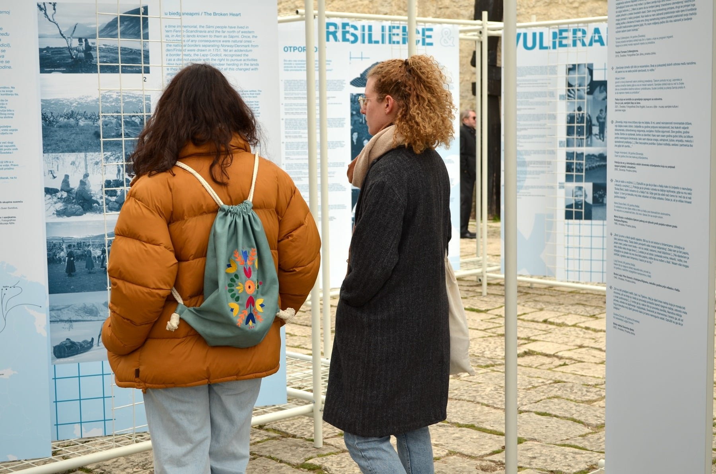
7 LOCAL EXHIBITIONS
1 TRAVELING JOINT EXHIBITION
10 COUNTRIES

Slide 10
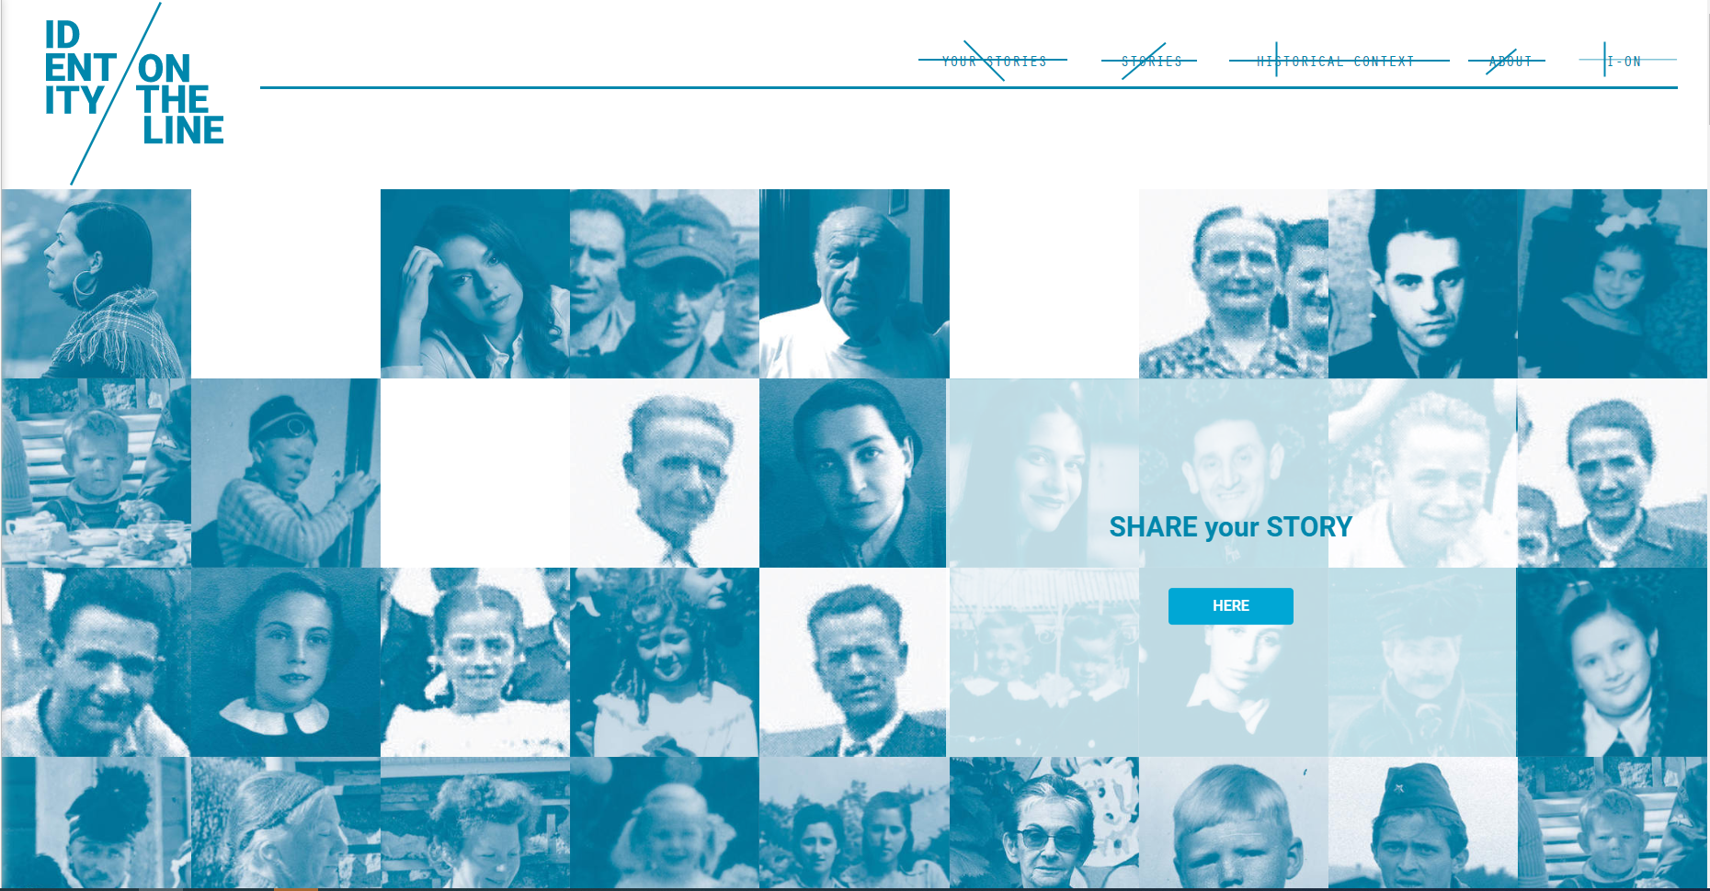
DIGITAL
JOINT EXHIBITION
www.identityontheline.eu

Slide 11

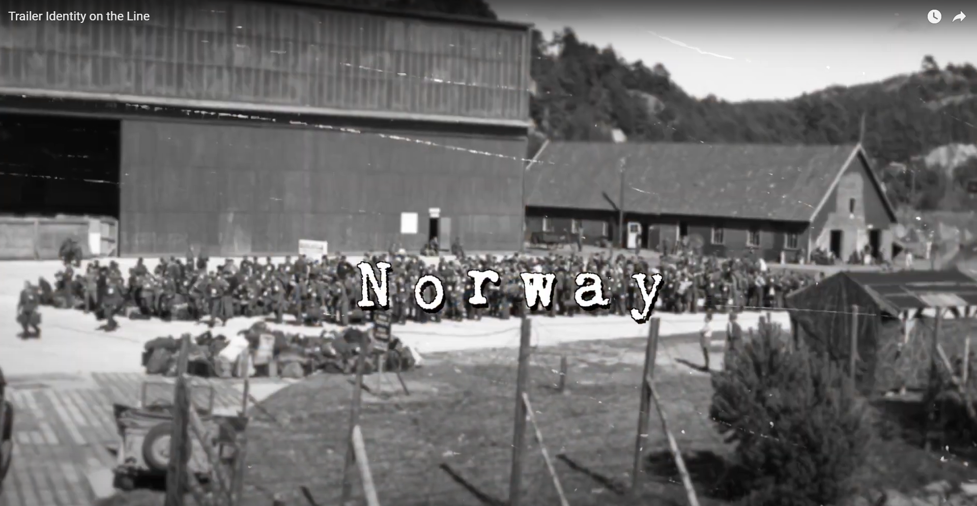
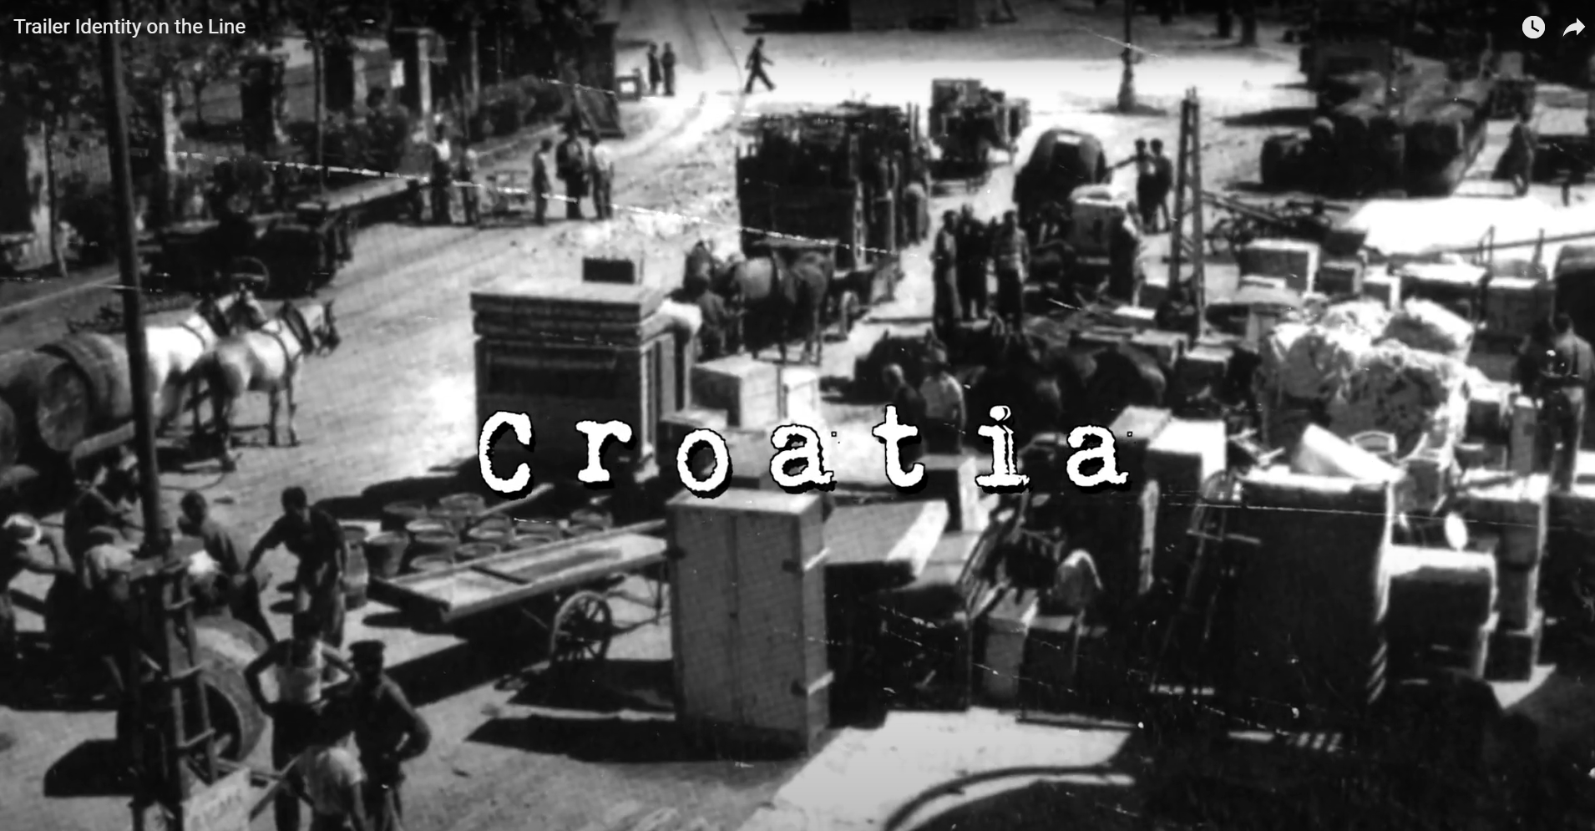
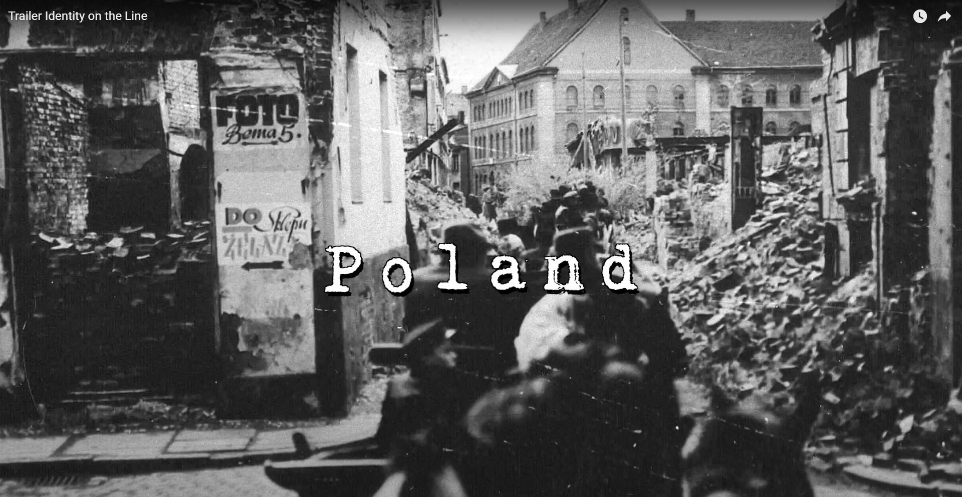
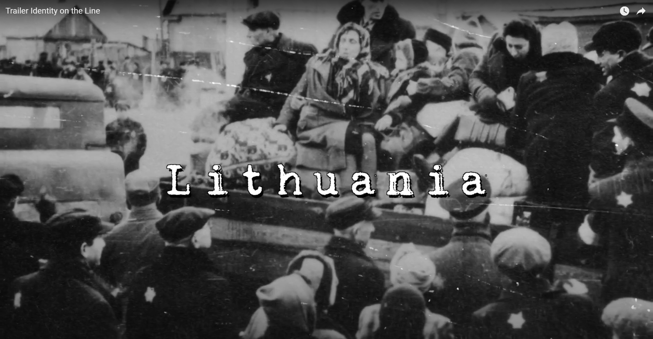
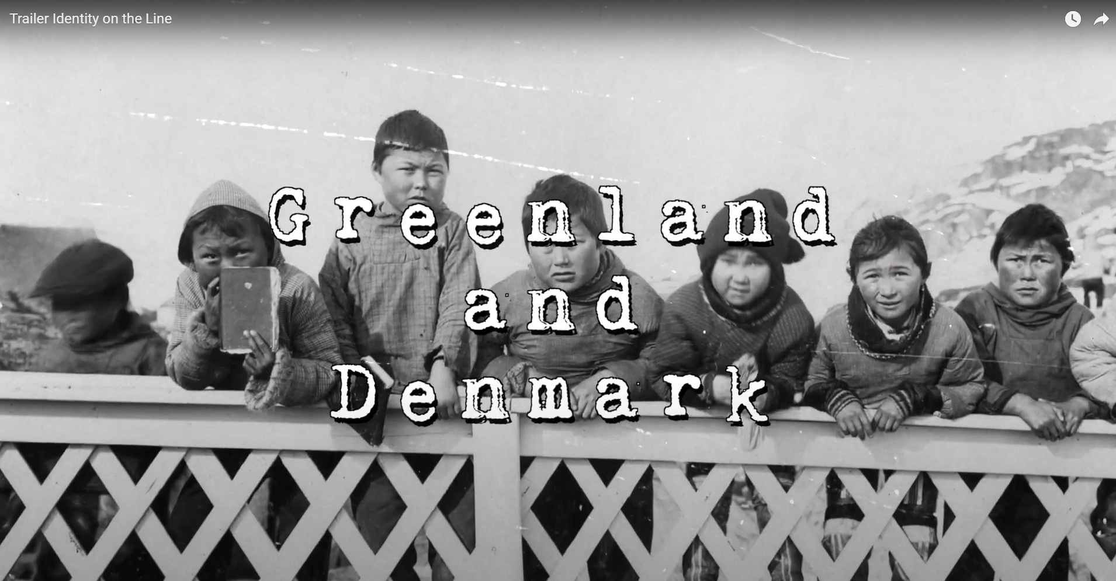
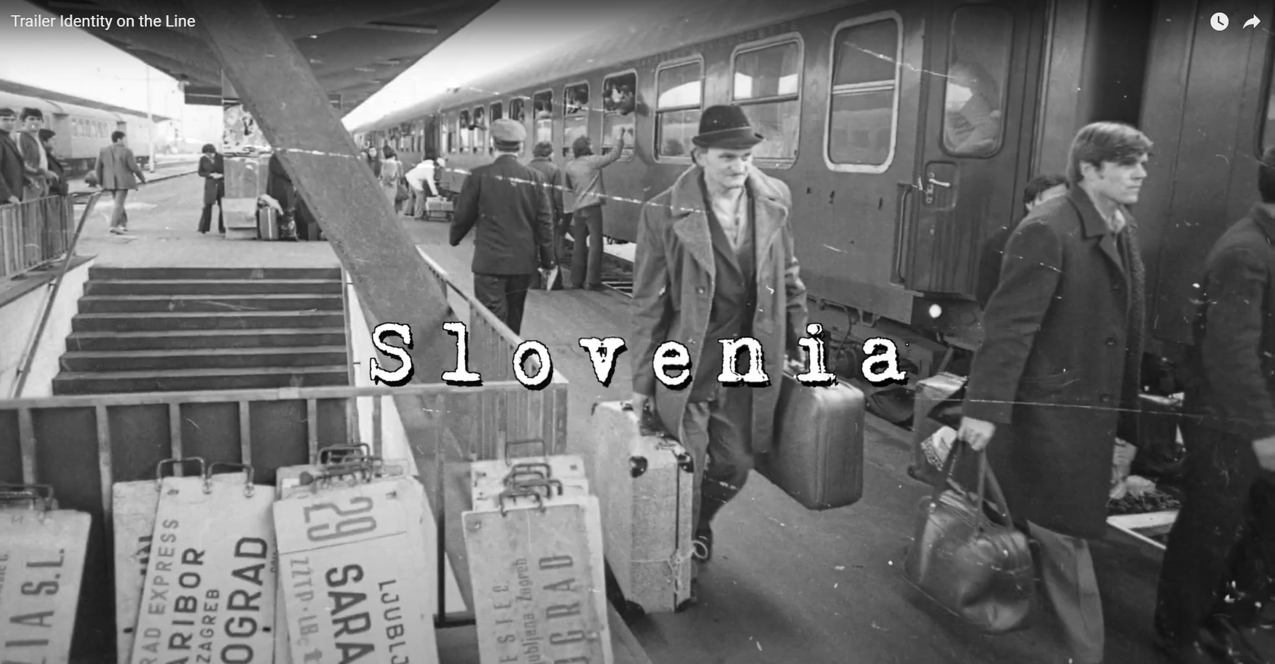
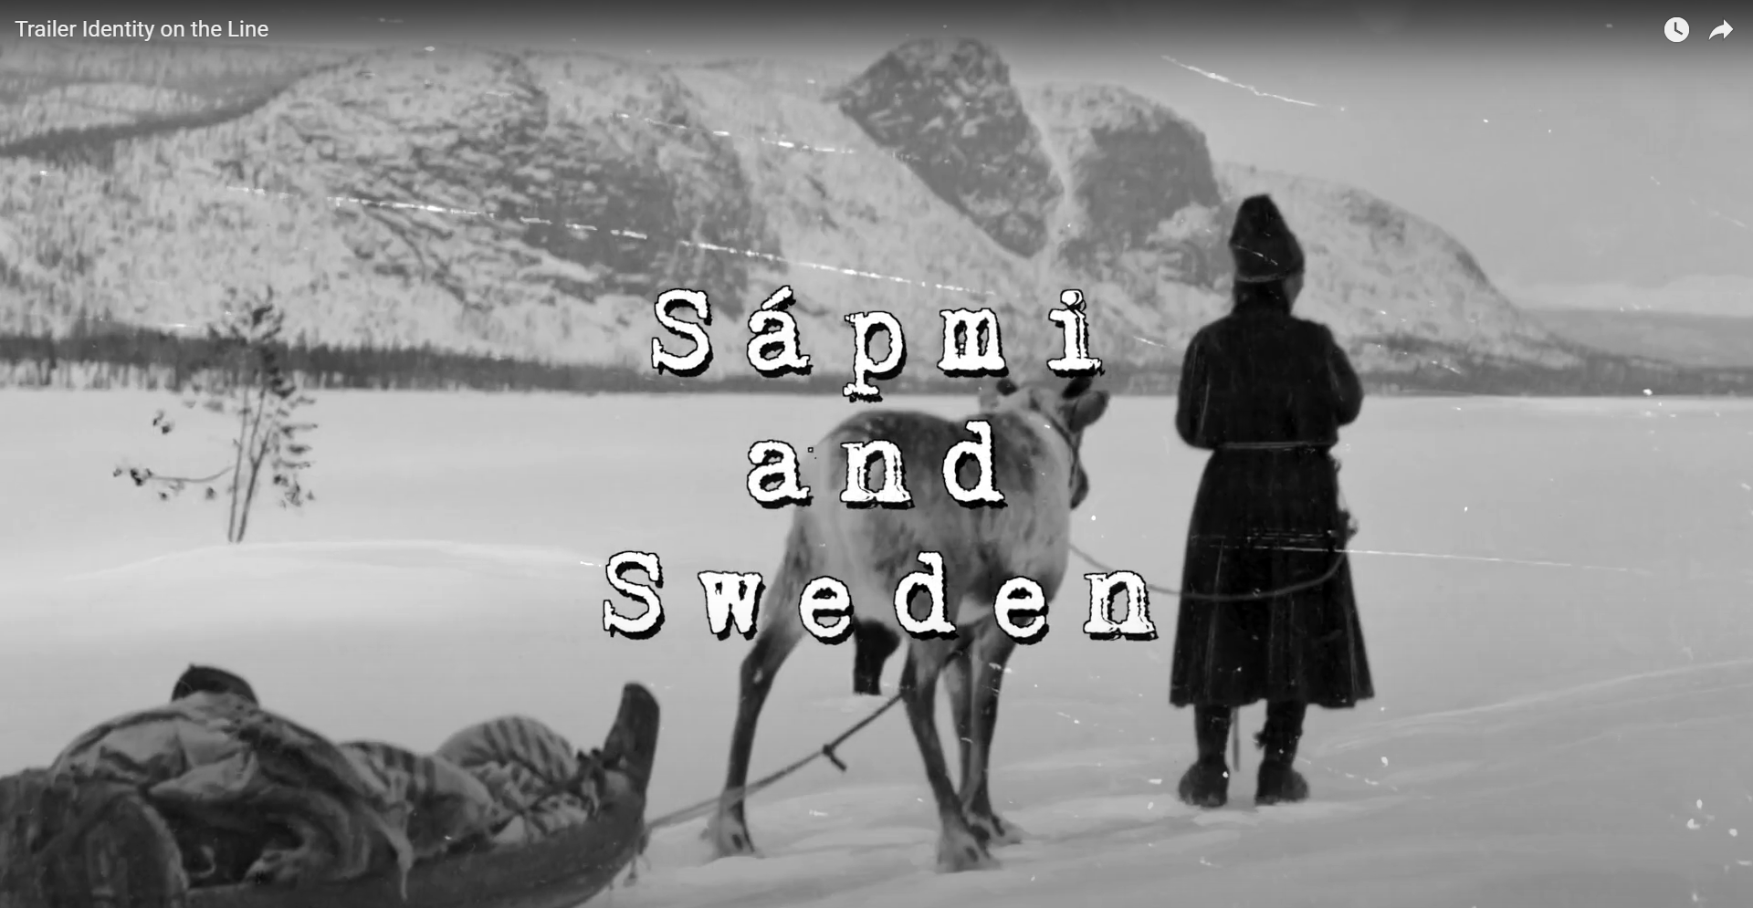
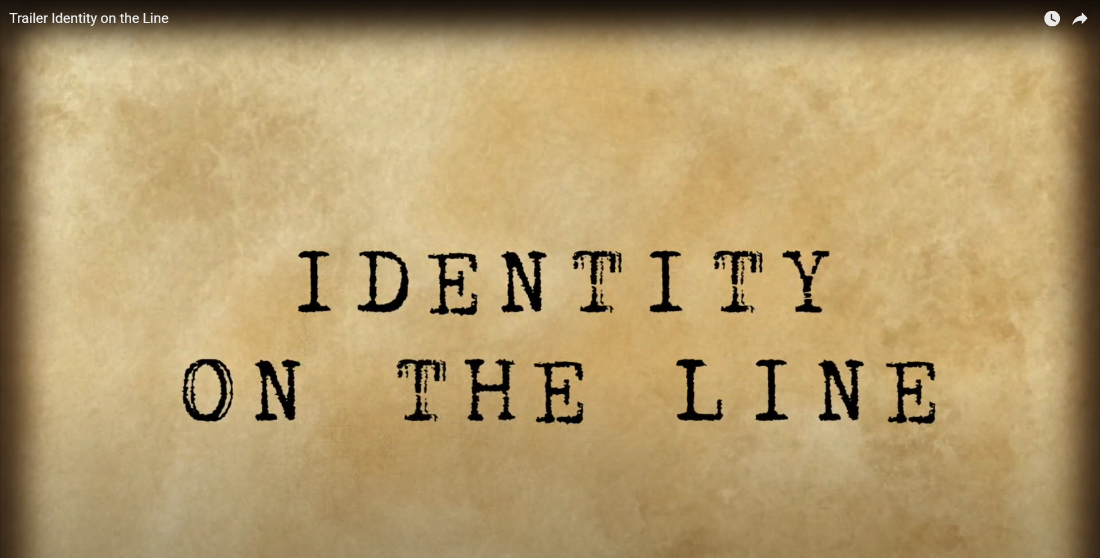
9 MOVIES
IN 8 LANGUAGES
DIGITAL
PACKAGES
1 MOVIE, 45 min
8 languages
1 TRAILER
7 MOVIES, 5 min each
8 languages

Slide 12
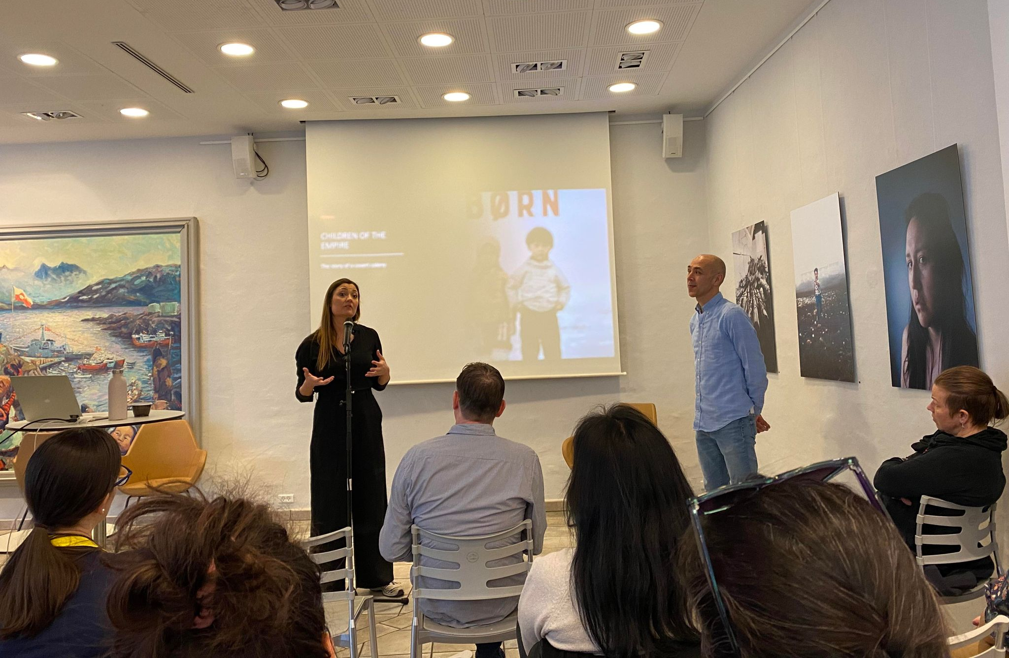
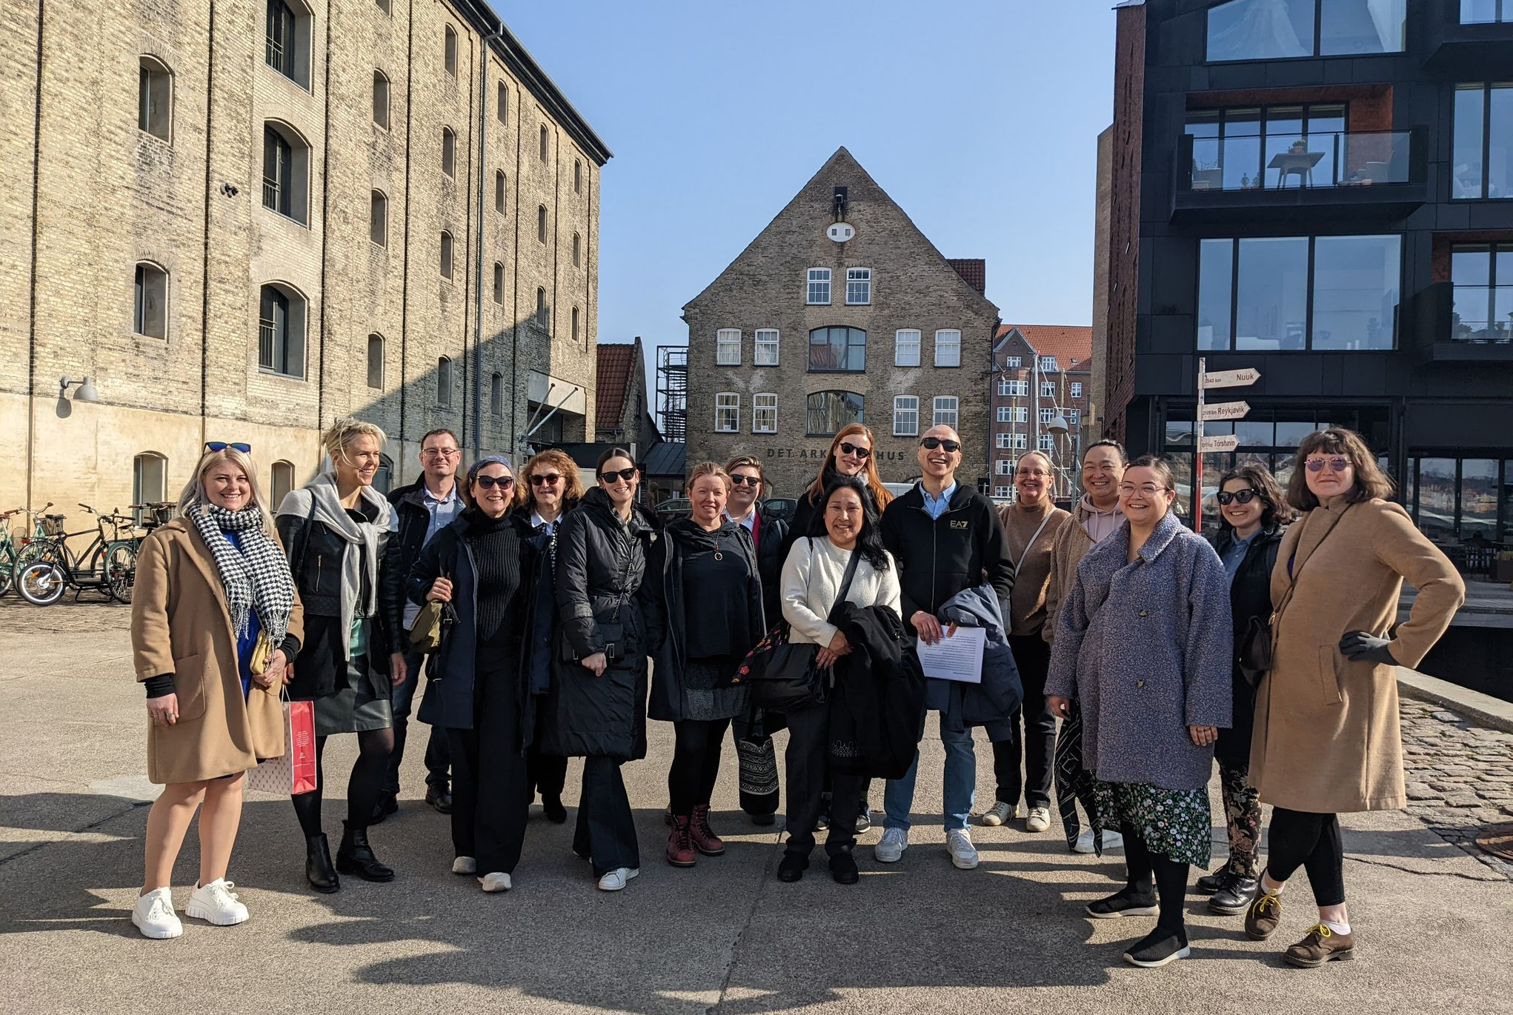


GUIDED VISITS to places of Rememberance
WEBINARS/
LECTURES
WORKSHOPS
7 GUIDED TOURS
7 WEBINARS
9 LECTURES

Slide 13

SCHOOL PACKAGES
8 LANGUAGES

Slide 14

SPIN-OFFs SO FAR
A continuously increasing network of colleagues interested in the same topic
New research project “What happens to the Untold?” (Norway)
New concepts of collaboration with informants (Slovenia)
New concepts to reaching out to children and students (Poland and Lithuania)
Collaborating with an Ukrainian film producer, documenting Crimean Tatars
Addressing colleagues and politicians in Brussels, 26th of April 2023

Slide 15




OUTREACH
3000 professionals in Europe have learned about I-ON
1.500.000 we have reached with our Social Media
Impact
8.000.000 have seen our news in seven countries
More than 60.000 visitors to the local and joint exhibitions

Slide 16

EMA
10.09.22
The European Museum Academy Prize recognises the outstanding results of organisations, researchers and cultural institutions in creating pioneering museums, or producing studies and carrying on projects of European relevance destined to influence the development of museological discourse at the international level.
In 2022, the EMA Board has decided to give the EMA Prize to I-ON, pointing out that:
The project unfolds common features of migration and its impact on future generations: children and grandchildren. It is about identities, basic human rights, discrimination. It is all about so-called difficult history.
The impressive outcome is a joint travelling exhibition, separate exhibitions in all countries concerned, publications, webinars, school packages and so on. It shows what mid-sized museums can achieve.
The project is for sure an important contribution to the understanding of the history of migration in the 20th century, thanks to its international exposure Europe-wide.

Slide 17

OUR TEAM

Slide 18


Slide 19
FINAL
CONFERENCE
26.04.23
«The Migratory Experience:
Adopting a three-generational Perspective»
Main question we want to explore today:
Why is a three-generational perspective important to adopt, and how could this be done?
Process & findings from Slovenia, Croatia, Norway, Lithuania, Poland, Denmark and Sweden
Launching of «Crimean Tatars»
Keynote by Dr. Wiebke Sievers
Senior Researcher at the Austian Academy of Science in Vienna
16:30 – 18:30: High-level roundtable at the Euroepan Parliament

