Slide 1
Gastric Balloon in Dubai
It is a minimally invasive procedure that helps individuals lose weight. In this procedure, the surgeon places a silicone balloon in the stomach. He then inflates the Gastric Balloon in Dubai with the saline solution. This Inflation occupies the space in the stomach and decreases the appetite of the person. It also makes the person fuller sooner. However, the doctors ask the patient to continue the diet and exercise with this procedure. The balloon lasts for six months or more in the stomach.

Slide 2
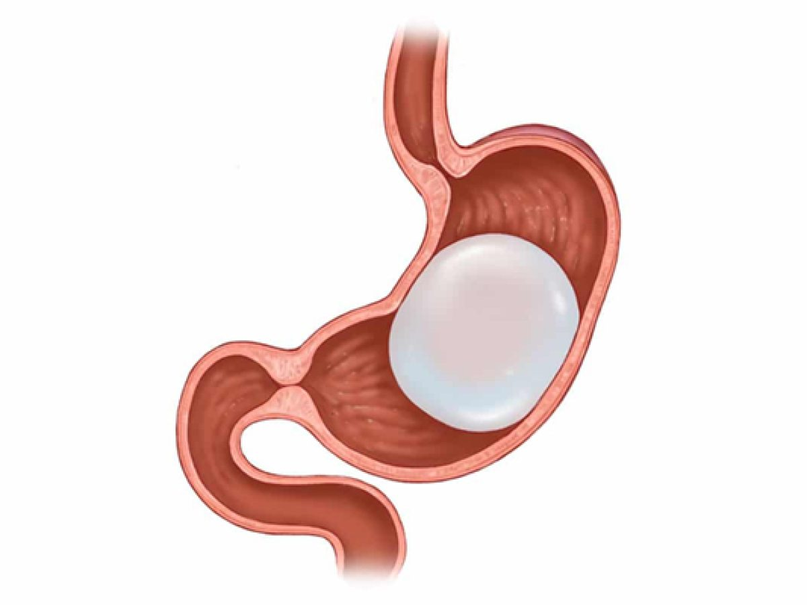
Gastric Balloon in Dubai

Slide 3
Gastric Balloon in Dubai
Obesity is a significant health concern affecting millions of people worldwide. It not only impacts physical health but also has far-reaching effects on fertility. Many individuals struggling with obesity are turning to Weight Loss in Dubai methods such as gastric balloons to help shed excess weight and improve their overall health.
However, there are concerns about whether Gastric Balloon in Dubai can affect fertility. In this article, we will explore the impact of gastric balloons on fertility, including the link between obesity and fertility, effects of weight loss on fertility, safety concerns, alternative weight loss methods, and conclude with a summary of findings and FAQs.
Introduction
Obesity has become a global epidemic, with over 650 million people classified as obese. It is a significant risk factor for various health conditions, including cardiovascular disease, diabetes, and infertility. To combat obesity, many people resort to weight loss methods such as dieting, exercise, and even surgical interventions like gastric bypass surgery. Gastric balloons, a less invasive option, have gained popularity in recent years. But what exactly is a gastric balloon, and how does it work?

Slide 4
Gastric Balloon in Dubai
What is a gastric balloon?
A Gastric Balloon in Dubai is a medical device that is inserted into the stomach to aid in weight loss. It is typically made of silicone and filled with saline solution or gas. The balloon occupies space in the stomach, creating a feeling of fullness and reducing the amount of food that can be consumed, leading to weight loss.
How does it work?
The Gastric Balloon Placement in Dubai is inserted into the stomach through a minimally invasive procedure, usually using an endoscope. Once in place, it is filled with the liquid or gas to expand and occupy space in the stomach. The balloon remains in the stomach for a certain period, usually six months, and is then removed.
Popularity of gastric balloons
Gastric balloons have gained popularity in recent years due to their less invasive nature compared to other weight loss methods like gastric bypass surgery. They are often recommended for individuals who are overweight or mildly obese and have not had success with traditional weight loss methods like dieting and exercise. Gastric balloons are also reversible, making them an attractive option for those who want a temporary weight loss solution.

Slide 5
Contact Us
Address: Villa 1091, Al Wasl Road, Al Manara Area (On the junction of AlThanya & Al Wasl Road) Dubai
Mobile: 971 561772998
Website: www.dynamiclinic.com

