Slide 1


Emend Aprepitant 125mg+80mg Capsules

Slide 2

About Aprepitanat Capsules
Emend is the trade name for generic drug Aprepitant. It
blocks the actions of chemicals in the body that trigger
nausea and vomiting. Emend Aprepitant is used in adults
and children to prevent nausea and vomiting caused by
Cancer chemotherapy. Aprepitant is also used (only in
adults) to prevent nausea and vomiting that may be caused
by surgery.

Slide 3

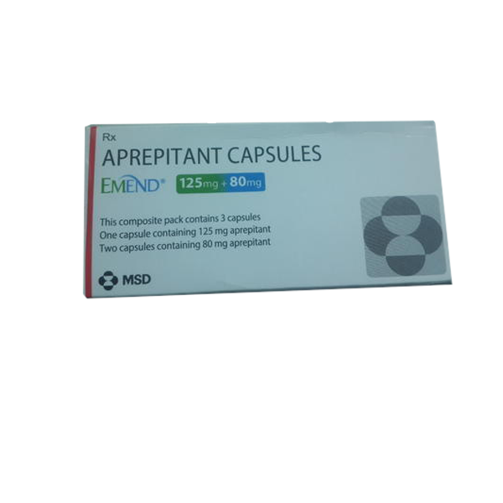
MSD Emend Aprepitant Capsules
Brand Name : Emend Capsules
Content : Aprepitant 125mg & Aprepitant 80mg
Manufactured by : MSD Pharmaceuticals Pvt Ltd
Form : Capsules
Packing : Pack of 3 capsules

Slide 4
Some Precautions To Be Taken While Consuming Aprepitant Capsules
Inform your doctor and pharmacist if you are allergic to aprepitant or any other medications.
If you buy any medicines, check with a pharmacist that they are suitable to take with your other medicines. This is because many other medicines can interfere with emend capsules and therefore may not be recommended for you.
Tell your doctor if you have or have ever had liver disease.
Speak your doctor if you are pregnant or breast-feeding. Do not breastfeed or pregnant while you are taking this drug.

Slide 5
Oddway International
Loyal, Dependable & Trustworthy
Established in 2010 , Oddway International, is one of
the leading wholesale pharmaceutical supplier of
Cancer, Hepatitis, HIV, Arthritis and other Life-Saving
Drugs to local as well as international markets. Our
international foot print covers countries in USA, UK,
China, Hong Kong, Russia, Japan, Singapore,
Thailand, London, New Zealand, Canada etc. Further,
The offered range is priced at a market leading rate and
is delivered in the timeliest manner.

Slide 6
Get In Touch With Us
E-mail : sales@oddwayinternational.com
QQ : 1523458453@qq.com
Phone : +91-11-43526658
Mobile : +91-9873336444
Skype | WeChat : Oddway2010
WhatsApp | Viber : +91-9873336444
Web Portal : www.oddwayinternational.com

Slide 7
THANK YOU

