Slide 1


OPERA BROWSER SUPPORT NUMBER
Get the best Opera browser support services from certified experts who are available 24*7
CALL TOLL-FREE USA : +(1)-888-846-5560

Slide 2

OPERA BROWSER COMMON ISSUES
Troubleshooting issues in private browsing
Unresponsive browser
Updates and reinstallation of the software
Blocking pop-up messages and ads
Enable security and privacy settings
Setting and configuration
Downloading flash player

Slide 3
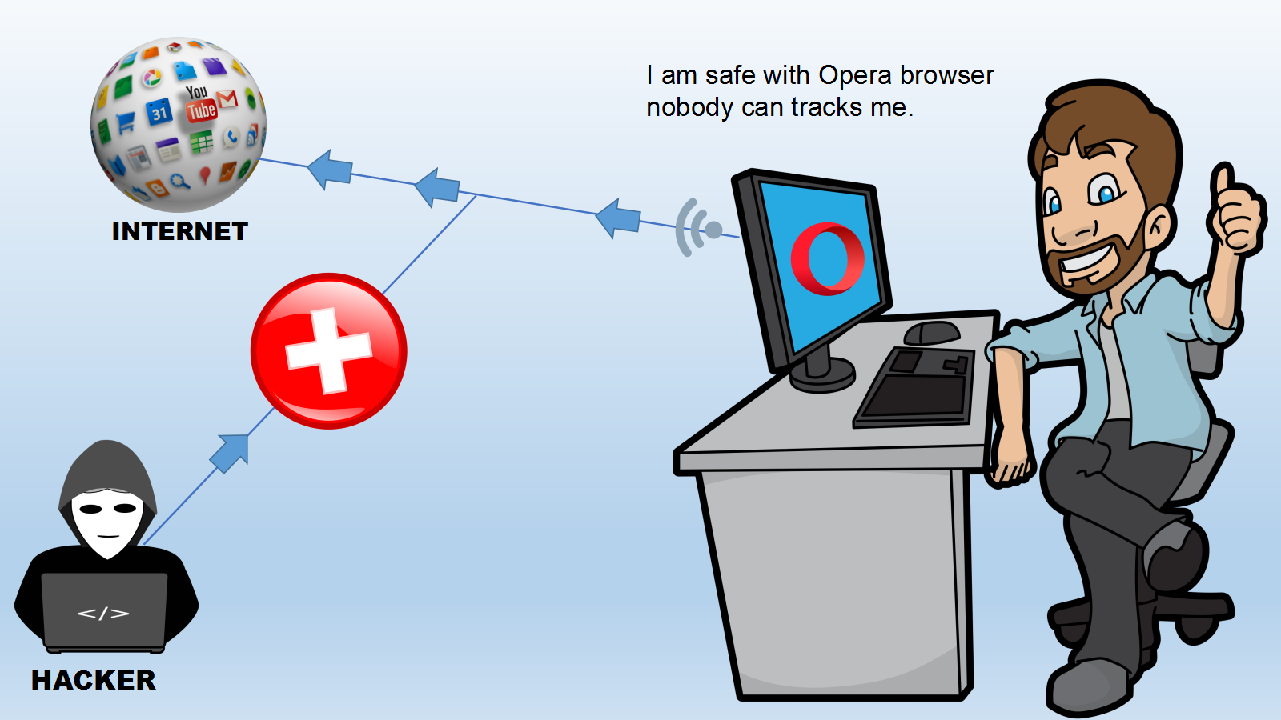

Slide 4
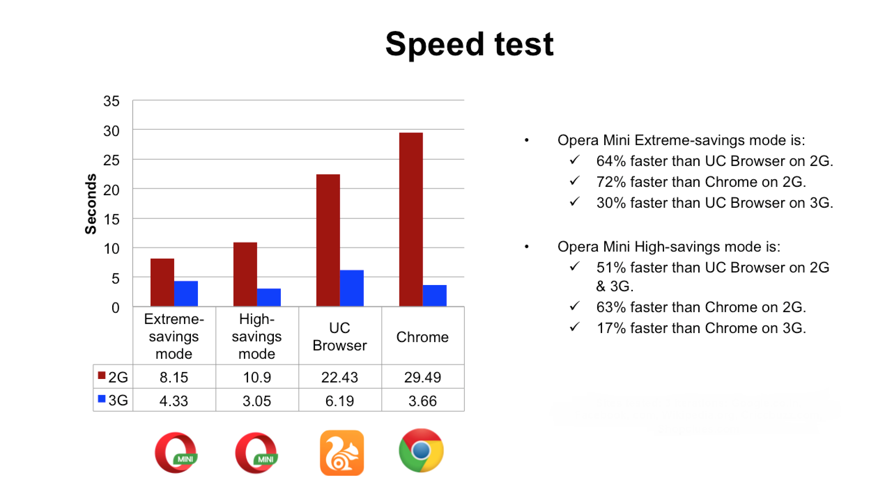

Slide 5



Slide 6


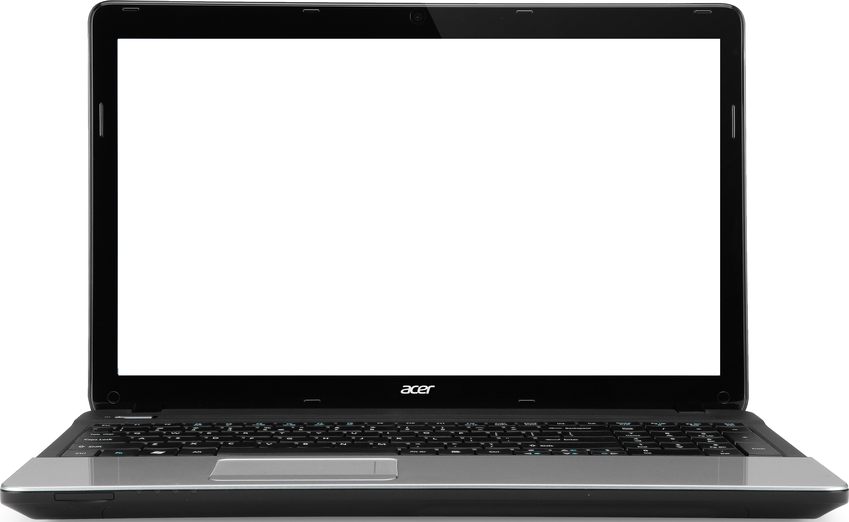



Slide 7

WHO WE ARE
Router Number Support is one of the leading router support service provider having worked for over six years in the industry. We have managed to gather a broad list of satisfied clientele who love to prefer us for their router-related problems.

Slide 8

CONTACT US
AT
READYNET ROUTER SUPPORT NUMBER
TOLL-FREE : +(1)-888-846-5560
AND
GET INSTANT SOLUTION
FOR
YOUR ROUTER ISSUES

Slide 9


Slide 10


