Slide 1
Gynecological Ultrasound in Saudi Arabia
A pelvic ultrasound is a painless symptomatic test that produces pictures that are utilized to evaluate organs and designs inside the female pelvis. A Gynecological Ultrasound in Saudi Arabia permits speedy representation of the female pelvic organs and designs including the uterus, cervix, vagina, fallopian cylinders and ovaries.

Slide 2
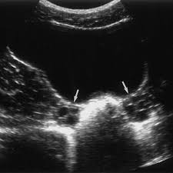
Gynecological Ultrasound in Saudi Arabia

Slide 3
Gynecological Ultrasound in Saudi Arabia
Gynecological ultrasound has emerged as an invaluable tool in women's healthcare, offering non-invasive insights into the female reproductive system. It has transformed the diagnostic landscape by enabling healthcare providers to visualize internal structures without resorting to more invasive procedures.
Gynecological ultrasound involves the use of sound waves to create detailed images of the uterus, ovaries, fallopian tubes, and surrounding structures. These images aid in the detection of abnormalities, such as cysts, fibroids, and tumors.

Slide 4
Gynecological Ultrasound in Saudi Arabia
The procedure is conducted in a comfortable environment. A gel is applied to the transducer, which is then moved over the area of interest. Patients may experience mild pressure during transvaginal ultrasound.
Gynecological ultrasound offers real-time imaging, aiding in immediate diagnosis. It's radiation-free, minimally invasive, and can be repeated as needed. It also allows for guided procedures like biopsies.

Slide 5
Contact us
Address: 6685 Wadi Alzarqa Street, An Nada, 3533, Riyadh 13317, Saudi Arabia
Phone: +966553978519
Website: Royalclinicsaudia.com

