Slide 1

Welcome To Call Girl In Singapore

Slide 2


We Are Providing Sexy Models Service In Singapore India etc.
Contact With Us For Any Quaries :- +6585041100

Slide 3

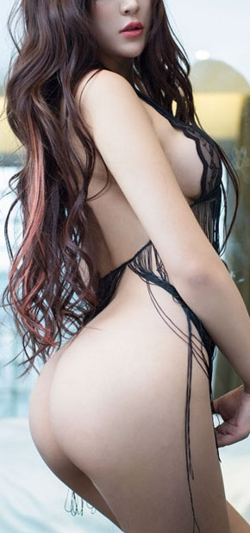
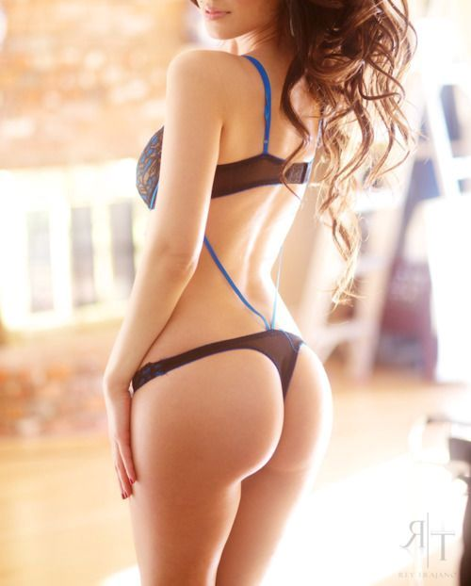
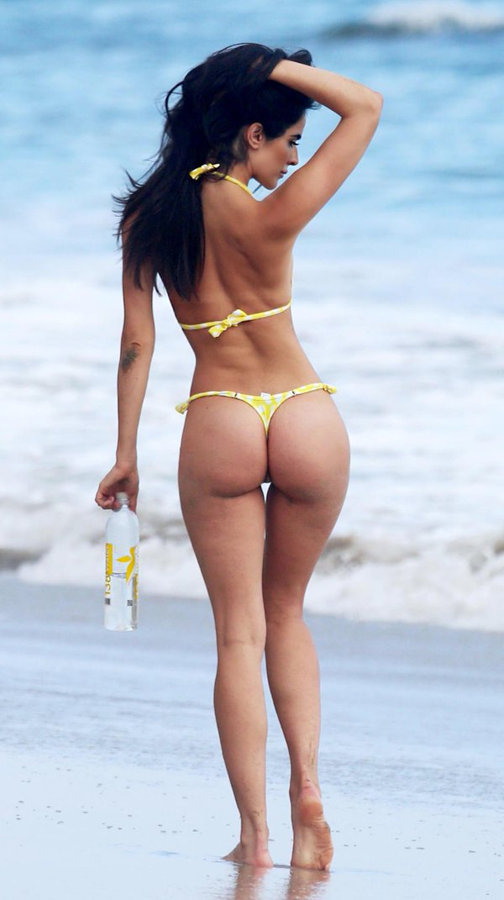
Sexy Singapore Models

Slide 4


Facebook
Plus google
Twitter
YouTube
Flickr

Slide 5
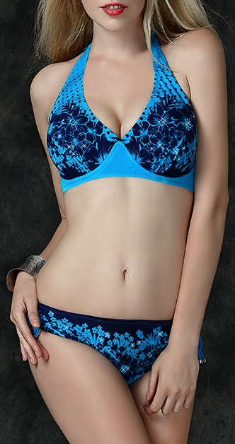
Visit Here:-
http://www.hotzareena.com/

Slide 6

Thanks For Watching Our Slide Show

