Slide 1
IV Drip Dubai
Do you need a solution to treat flu symptoms, fatigue, and jet lag? Or are you looking for way to look fresher, cleanse your body of toxins, and increase your energy levels. It may sound like you need more than one treatment, but the IV Drip Dubai can prove this otherwise.

Slide 2
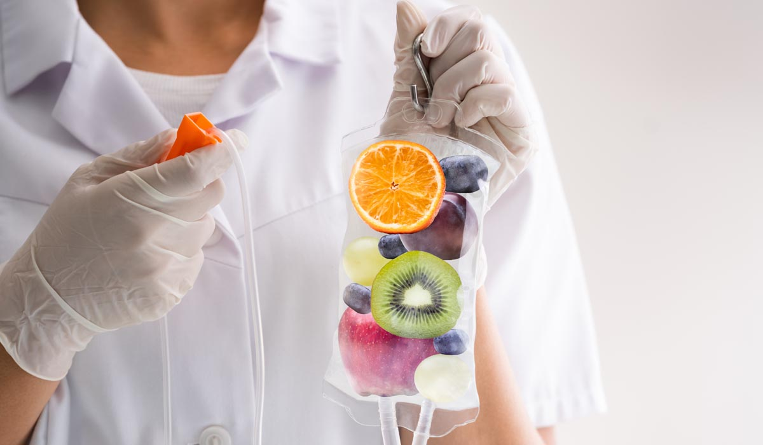
IV Drip Dubai

Slide 3
IV Drip Dubai
IV Drip Dubai is a popular health and wellness service in Dubai, United Arab Emirates, that offers intravenous (IV) therapy.
IV therapy, also known as IV drip, is a medical treatment that involves the direct infusion of vitamins, minerals, and other nutrients into the bloodstream through a vein.
IV Drip Dubai provides a range of IV therapies designed to address various health concerns and promote well-being. These therapies may include options such as immune-boosting drips, hydration drips, energy-boosting drips, detoxification drips, and beauty-enhancing drips.
IV Drip Dubai typically offers customized IV drips tailored to individual needs, which are administered by trained healthcare professionals in a safe and controlled environment.

Slide 4
IV Drip Dubai
IV Drip Dubai is often sought after by those who are looking for a convenient and efficient way to receive essential nutrients directly into their bloodstream, bypassing the digestive system for faster absorption.
The therapy is commonly used by individuals seeking to improve their overall health, enhance their immune system, rehydrate after physical activity, replenish essential nutrients, and optimize their well-being.
It's important to note that IV therapy should always be administered under the guidance of a qualified healthcare professional, and the specific benefits and risks of the treatment should be discussed with a medical provider before undergoing any IV therapy.

Slide 5
Contact Us
Address: Villa 1091, Al Wasl Road, Al Manara Area (On the junction of AlThanya & Al Wasl Road) Dubai
Mobile: 971 561772998
Website: www.dynamiclinic.com

