Slide 1


Binary Options Signals
You can find reviews of some of the best, most renowned and dependable binary options traders

Slide 2
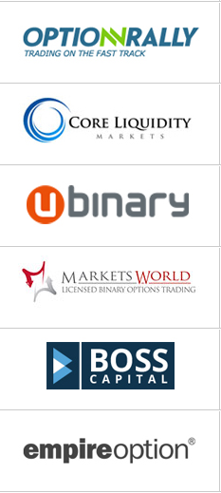
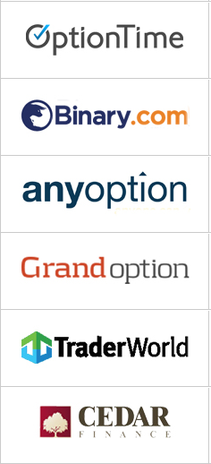
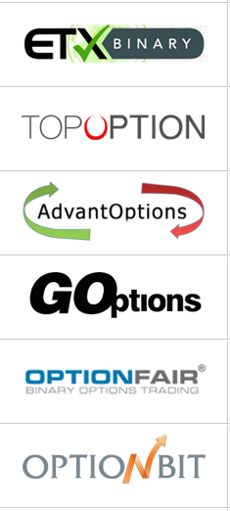
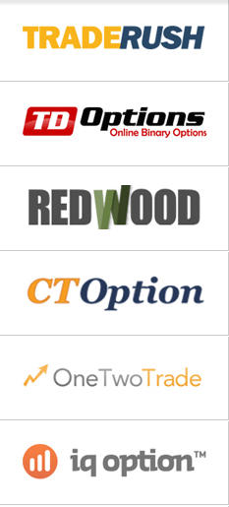
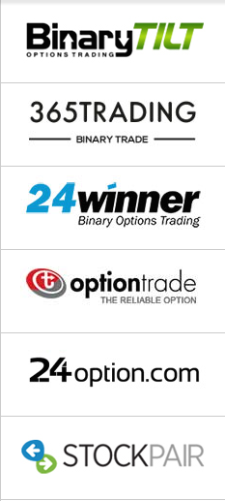
Index
Binary Options Demo Account
Binary Options Signals
Binary Option Strategies
Binary Options Trading Strategy

Slide 3

Binary Options Demo Account
Binary Options demo accounts are valuable assets to both novice and experienced traders alike. Many new traders sign up with a broker, make their deposit and wonder why they lose it all in a short period of time. There are many reasons for this but using a demo account will certainly help your chances of success.

Slide 4
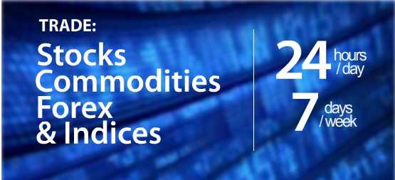
Some Signals providers will offer you a demo by charging lesser than they generally do, typically $5 – $7 for a short period in which you can try out the signals, others will give you a money back guarantee instead of a free demo. If you are not satisfied with the Signals service after you have tried it for a few days, you can simply ask for a refund.
If your Binary Options Broker offers a demo account (one with virtual currency), then it would help if you tried out the signals from a service you have just signed up with on it for a week or so instead of trading with your real money. This way you can reduce your losses to zero if the signals happen to be inaccurate – simply cancel your subscription and ask for a refund.
Binary Options Demo Account

Slide 5

Binary Options Signals
Binary Options may be simple to understand, but that does not mean that they do not come with a steep learning curve, in fact like most other forms of financial trading, they require the trader to have at least a passing knowledge of how the market works and making most of your trades successful is a skill that can only come by investing money and trying out binary options trading yourself, for a while at least. However, THERE IS AN ALTERNATIVE!! – you can sign up with a signals provider and benefit from their experience.

Slide 6
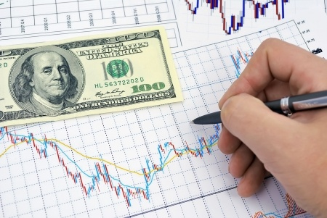
Methods of Delivery Used By Binary Options Signal Providers
In order for signals to work for Binary Options trading, they must reach the recipients in a timely manner as a difference of even a single pip can render the signal useless, especially since they tell the user not only what course of action to take but also when they should do it. To this effect, Binary Options Signal providers thus use certain delivery methods to get the information across to their clients, here the main ones used:
SMS
Skype (or other Instant Messengers)
Email
Websites
Binary Options Signals

Slide 7

To mitigate the risk that is inherent in binary option trading, most brokers will provide you with up to date data which you can use to make well informed decisions. This usually includes charts and news feed from reliable sources such as Reuters and investment banks which the broker has subscribed to.
Binary Options Signals
Now in most cases, traders try and use this information to work out how an asset will trend within the time of the expiry of a contract; if the asset trends according to their predictions then they make a nice return, but if it doesn’t then they have lost their investment.

Slide 8
Binary Option Strategies
Binary options trading is one of the least difficult ways to trade with popular assets. Traders need only correctly predict the upcoming direction of asset price movement in order to earn money. Furthermore, start-up costs as low and return rates are high. As simple as this form of trading may sound, there is more to it. It takes more than guesswork to accurately forecast future price movement, and this is where strategies enter the picture.

Slide 9


Binary Option Strategies
Strategies come in many different forms, a fact which can make the selection process a bit of a challenge. What’s most important is that the strategy has been tested and pairs well with the type of trade you plan to use. It is equally important to follow the exact steps laid out when using pre-designed strategies. There are plenty of potent methods that have been designed by industry experts and made available for free online. Many of these have been tested and are verified to be efficient.
It’s quite important analyze past price action, along with the current price movement of any asset you’d like to trade with. Evaluation of past price movement will help you to identify upcoming trends and can also point out volatility.

Slide 10
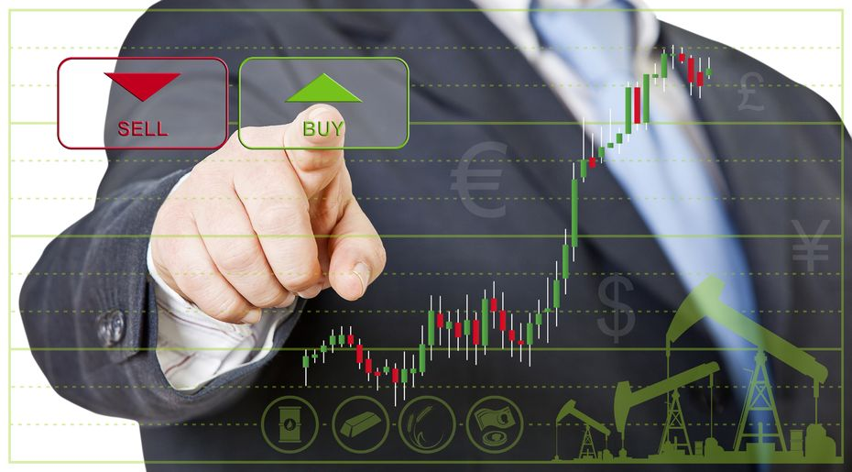
Binary Options Trading Strategy
The objective is to simply select a particular asset, ideally one that is trending at the time, and then enter into trades along with the direction of the trend. Live asset price charts are supplied by all brokers. These can be viewed for various time periods, with some also showing historical data. Clear upward or downward price action can lead to one or more lucrative trades. This makes it possible for you to earn profits from multiple trades very quickly.

Slide 11

Binary Options Trading Strategy
With experience comes the natural ability to identify outstanding fast trade opportunities. While some traders decide to trade solely with brief expiration times, it’s important to remember that these trades aren’t always the best match for all types of market conditions. Any solid binary options broker is going to supply several different instruments, which means that you should always have access to a suitable instrument to pair with existing market conditions.

Slide 12






Binary Options Signals
www.binarycontrast.com

