Slide 1
Download alexa application for windows 7 pc
It is extremely simple to Download Alexa application for the windows PC. You can utilize Alexa application on the constrained PC as it were. Since the greater part of the PCs don't have the good firmware for the Alexa application. You can utilize Alexa application effectively in as of late propelled PCs. These PCs are good with your Alexa application. You can utilize your Alexa App on PC.

Slide 2
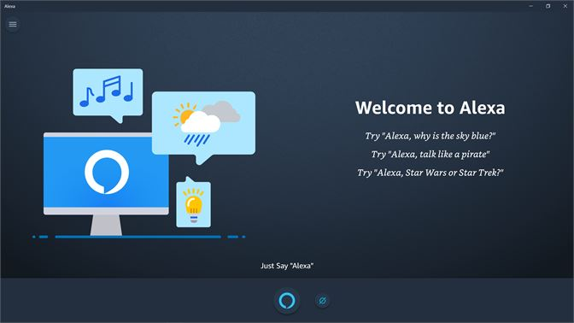

Slide 3
Alexa has increased broad acknowledgment in worldwide. clients over the world are the use of the Alexa application on their Android and iOS gadgets, yet now they can, Download alexa application for windows 7 and utilize this application at the PC and PCs. One part that a buyer ought to battle with before downloading the application is that each gadget has an unmistakable prerequisite to download the Alexa.
You don't have to play out any totally various strides to download and introduce the Alexa application on Pc. Follow the means referenced and indicated beneath, Download Alexa App for Windows 10, 8, 7. The application for Amazon Alexa is constrained only to PCs sold through HP, Lenovo, and Acer, yet you introduce it to any PC. Obviously, there are a few provisos, yet for the individuals who need a look at what Alexa can do you for you in a hurry, this is the thing that you have to begin.

Slide 4
Setup the Alexa application on Windows 7
1. Once the App get downloaded on your gadgets, open the download organizer and discover your Alexa App record.
2. Open the document and hit on "Run" to begin the establishment procedure.
3. When your Alexa App gets introduced, restart your PC.
4. Now, Open the Windows 7 Start Menu and run Alexa App.
5. Click on "Set up Alexa"
It is the most good internet browser to download the Alexa application on your Windows 7 PC. You can likewise visit the site for getting to the Alexa application without downloading it.
In the event that you need to Download Alexa application on your windows PC. At that point You need to play out a similar procedure which we have expressed above to introduce and utilize that Alexa application on your windows PC. You don't have to play out any various strides to download and introduce the Alexa application on PC. These abilities will help you in performing different undertakings. Download Alexa application for a Firestick. Amazon Provides you with a wide scope of 75000 Alexa abilities. Which you can include your Alexa application for windows.
Now and then Alexa doesn't comprehend the voice guidelines of its clients. Would you be able to Download Amazon Alexa application on Computer? These are probably the most widely recognized issues which individuals face while utilizing Alexa application on their Windows PC. On the off chance that you need to get in touch with us.

Slide 5
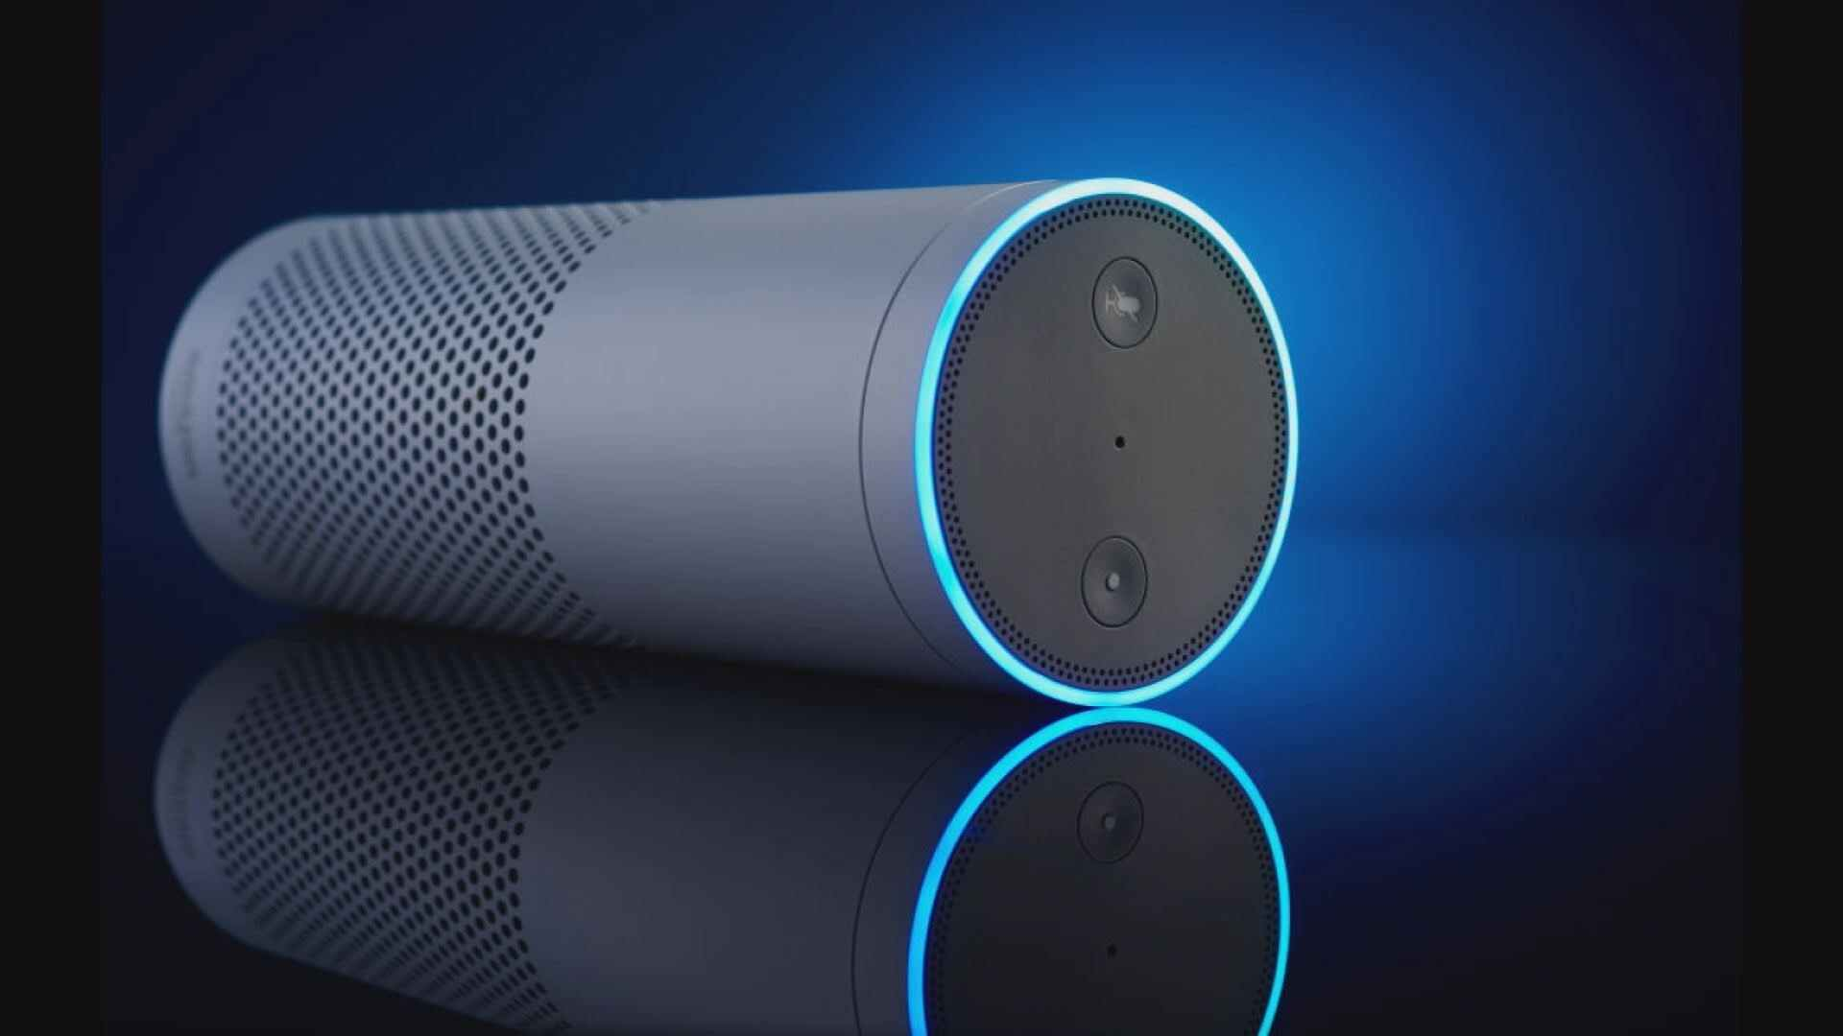

Slide 6
on the off chance that you do now not have the product pre-snared, you can have Alexa application download home windows 7 through of the product control instrument on your framework and afterward set up the utility.
The Alexa for Windows 10 application fuses access to now playing to control music and the limit, like some other Alexa application, to control insightful home devices. Video, calls, Spotify, and Pandora are on the whole not presently upheld inside this Alexa for Windows 10 application, however. Amazon hasn't added PC explicit controls to ask Alexa to do get to Windows highlights, however Amazon says "PC-explicit capacities will be included mid 2019 notwithstanding progressing highlight refreshes."
For more information visit us from the link below :- https://www.setupechodots.com

